Slide 1
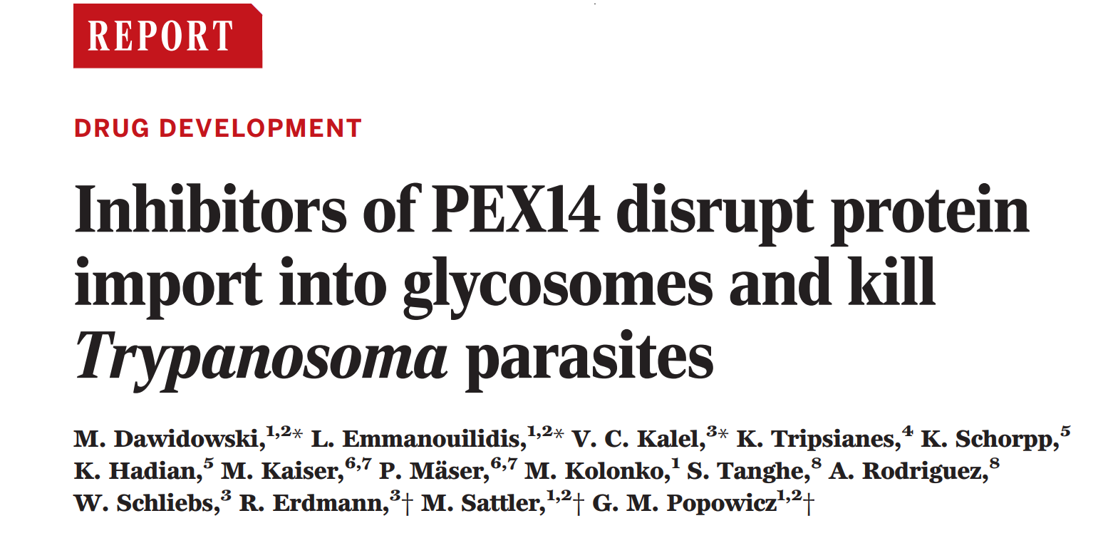
Drug Target Identification in Tropical Pathogens Seminar
Theresa Thanner
14.05.2020

Slide 2
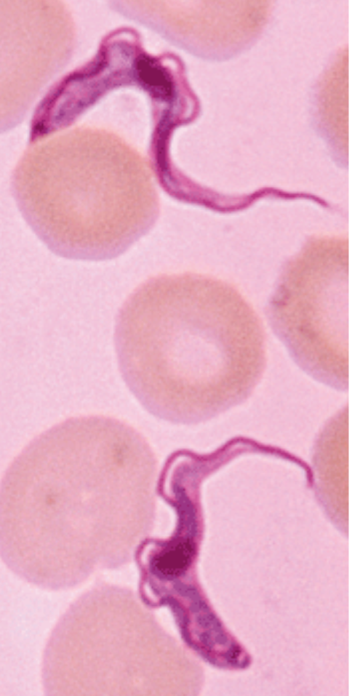
Trypanosoma
unicellular parasitic eukaryotes
Kinetoplastida
transmitted via vector hosts
Cause severe diseases
  Trypanosoma brucei gambiense → sleeping sickness
  Trypanosoma cruzi → Chagas disease
Problems with medication:
insufficent availability of treatment
Severe side effects
https://science.sciencemag.org/content/348/6238/974/F2

Slide 3
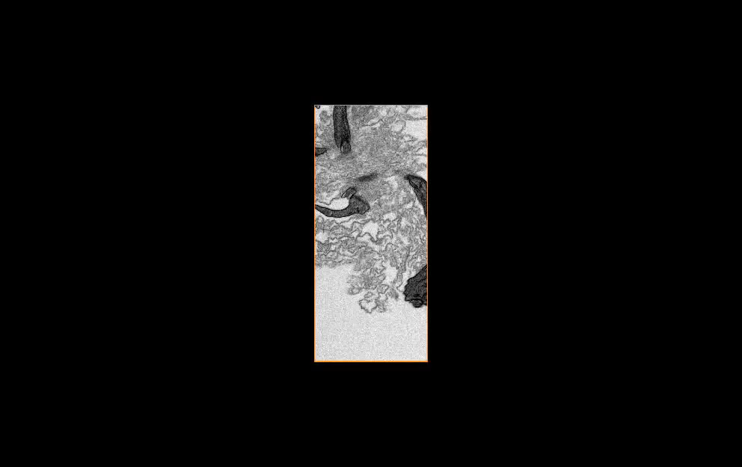

Slide 4
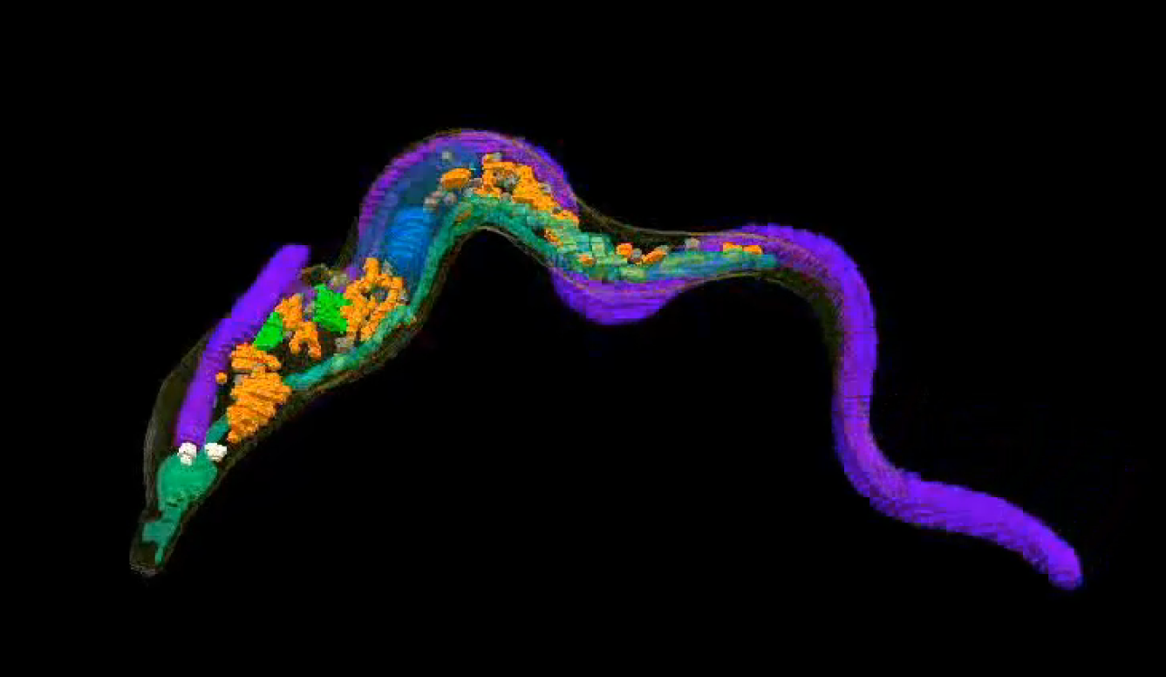
Nucleus
Flagellum
Glycosomes
Kinetoplast

Slide 5
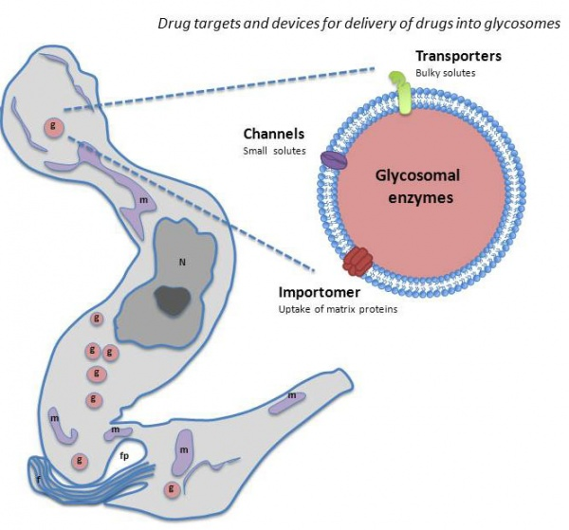
Glycosomes
Small organelles evolved from peroxisomes
Only few species of protozoa have glycosomes
Glykogen matrix
Important for metabolism (glycolysis)
Pex (Peroxin) proteins
  Pex14 membrane protein
  Pex14 RNAi → cell death
[Gualdron-Lopez M, et. Al “Channel forming activities in the glycosomal fraction from the bloodstream form of Trypanosoma brucei” ]

Slide 6
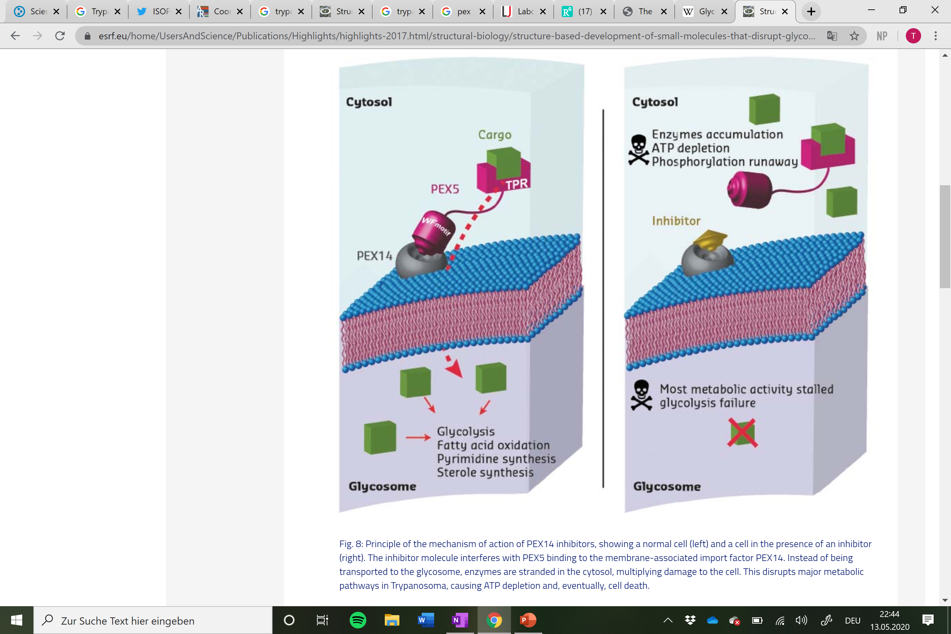
Pex14 Inhibitor
Pex 5
C-Terminus TPR binds PTS
PTS = Peroxisom Targeting Signal
TPR = Tetratripcopeptide

Slide 7
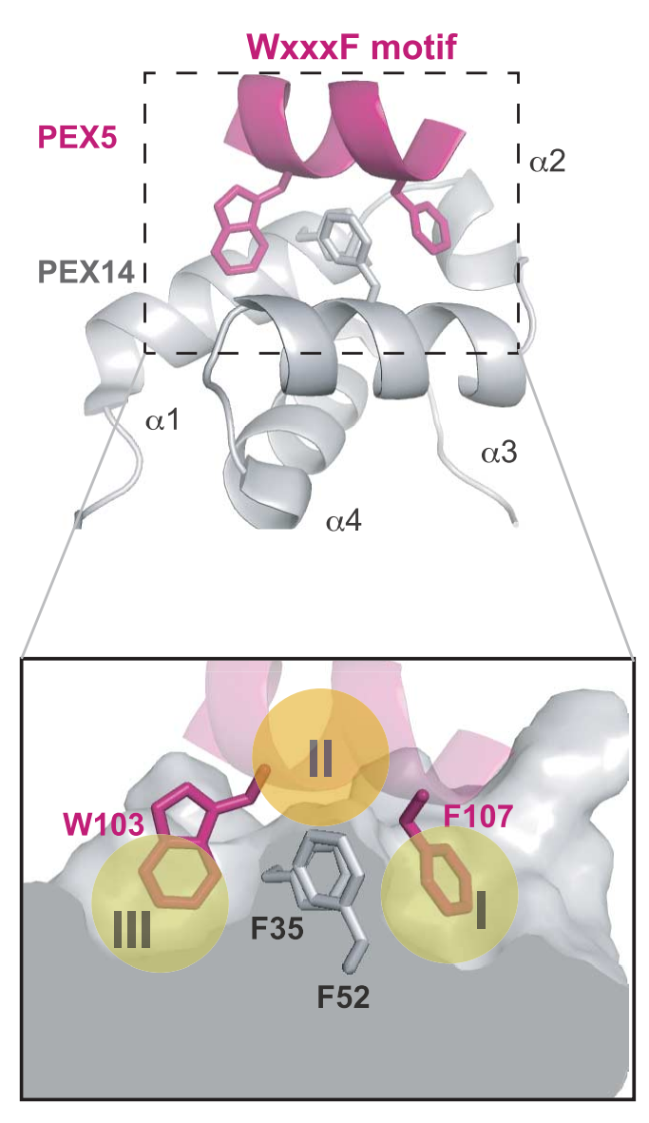
Pex14-pex5 binding
interaction
II
Center of binding site
π Stacking of F35 and F52 (pex14)
Hydrophobic pocket
Binds W103 of pex5
III
I
Hydrophobic pocket
Binds F107 of pex5

Slide 8
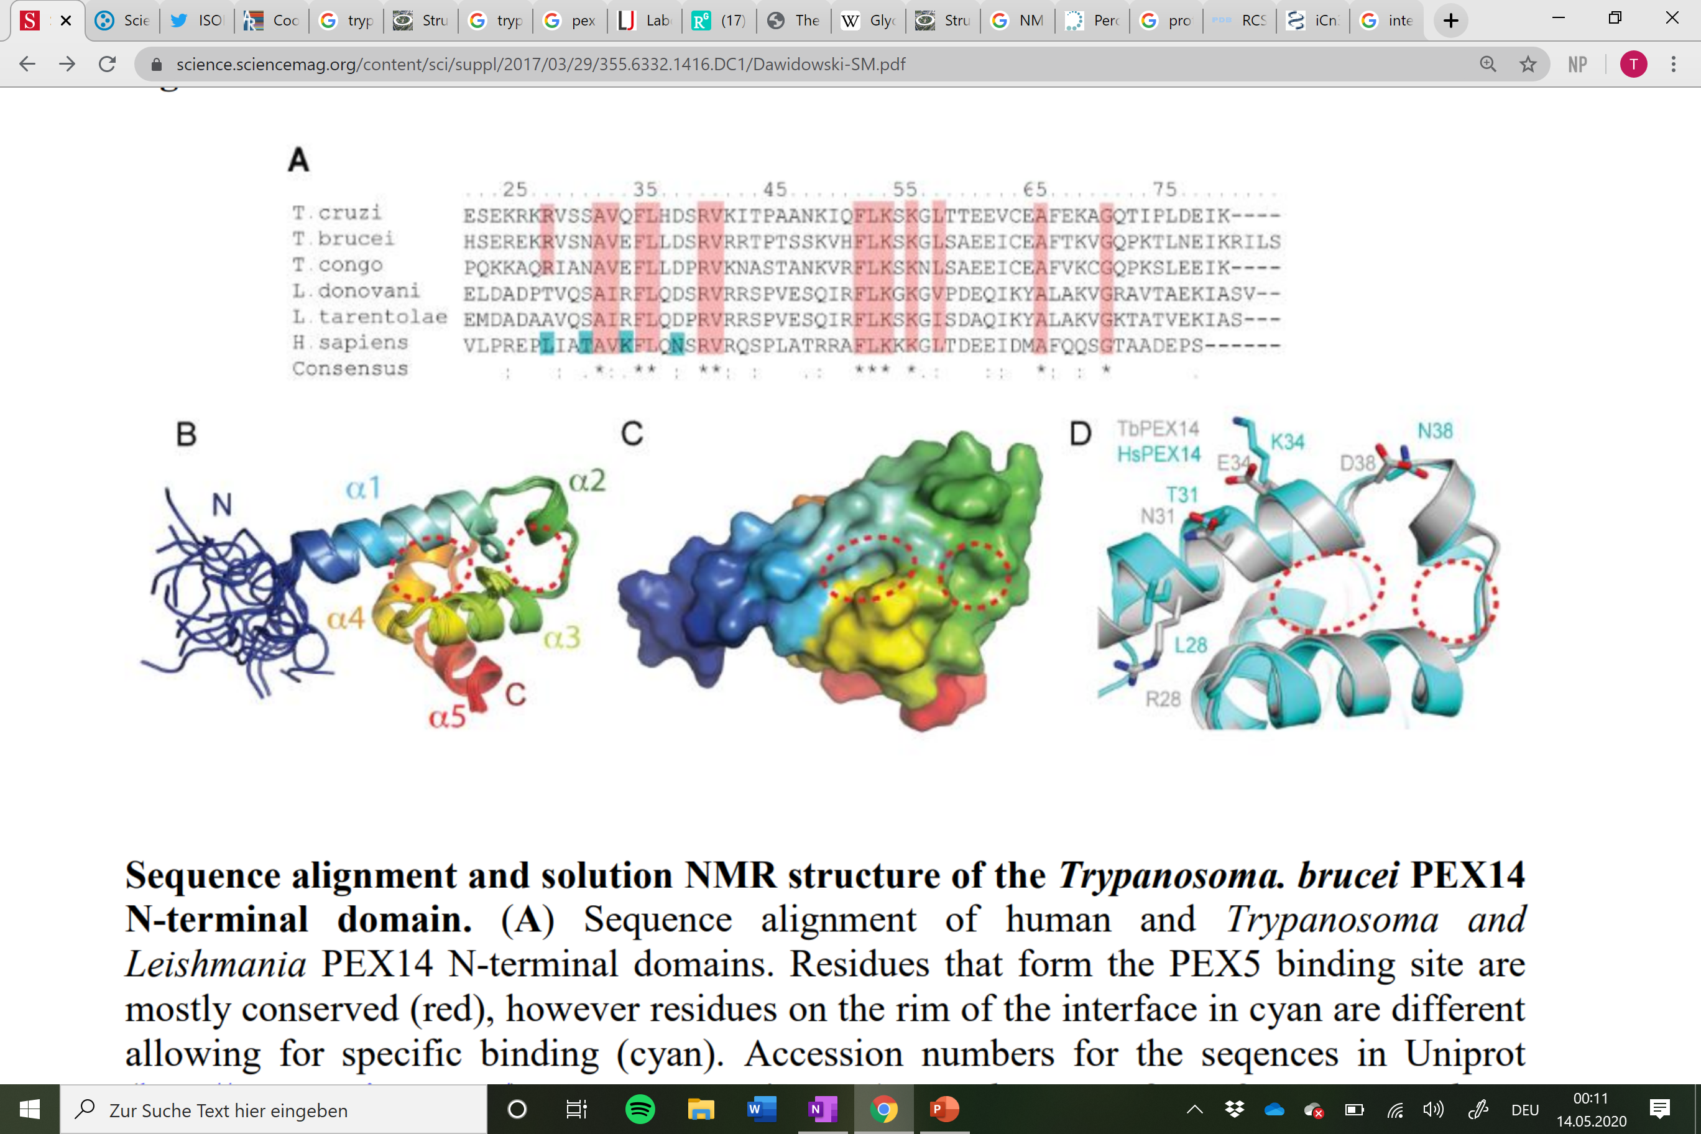
Problem: You don‘t want to kill the host
Pex5 binding site = mostly conserved (marked red)
Differences near the binding site!
Specific targeting of Tbpex14 is needed!

Slide 9
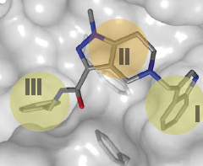
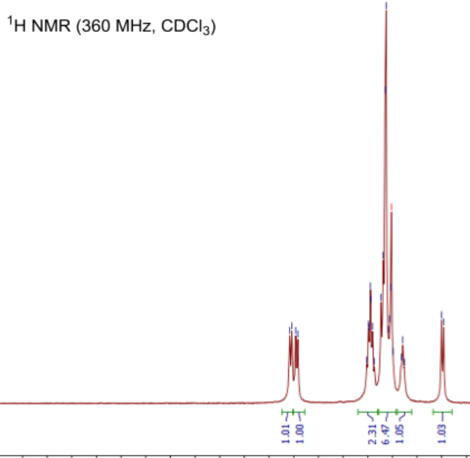
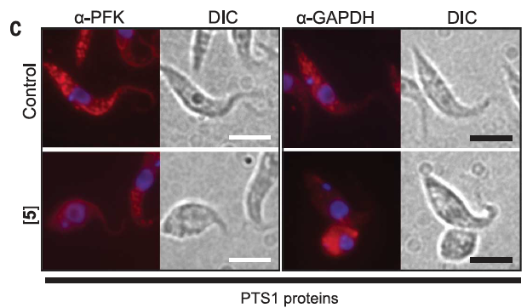
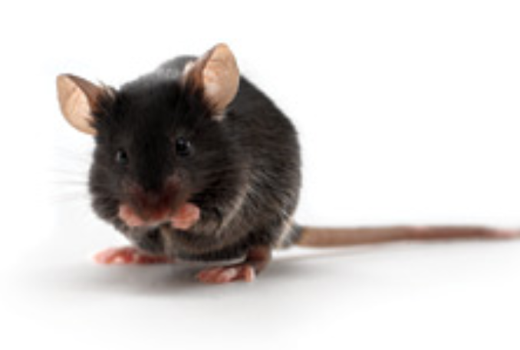
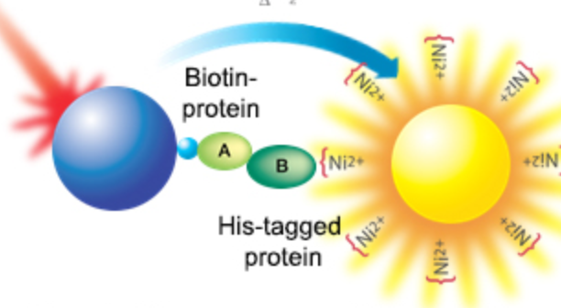
Drug development steps
3D Phamacophor based Screening
1H-15N heteronuclear NMR Spec
Alpha Screen
In vivo validaton
Animal model experiments

Slide 10
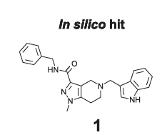
Pharmacophor 3D Model
Screening for compounds possible with various software
e.g: Pharmer, Catalyst, DISCOtech, LigandScout , MOE, and PHASE
Compare to available libraries: ZINC library of 21 million commercially available compounds
pyrazolo[4,3-c]pyridine derivative
Best hit: Compound 1

Slide 11
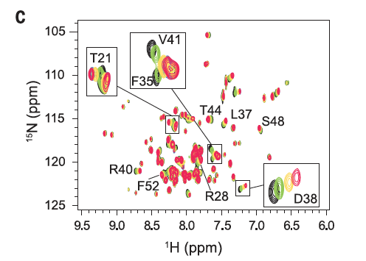
Validation of binding with 1H-15N heteronuclear NMR Spec
Nuclear Magnetic Resonance (NMR) spectroscopy
Based on nucleus spin
number of neutrons and the number of protons are both even, then the nucleus has NO spin.
If the number of neutrons plus the number of protons is odd, then the nucleus has a half- spin
If the number of neutrons and the number of protons are both odd, then the nucleus has an + spin
Magnetic field: atoms move according to nuclear spin (depended on surrounding atoms)
0µM
50µM
100µM
500µM
100 µM 15N-labelled PEX14 N-terminal domain added increasing pex5 concentrations

Slide 12
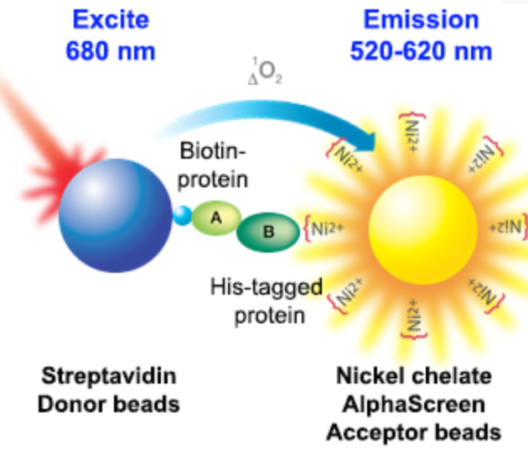
Alpha Screen Method
Alpha (Amplified Luminescent Proximity Homogeneous Assay) Screen
→ Protein – Protein interaction detected by luminescense
680nm → donor bead produces singlet oxygen
which diffuses to Acceptor beads within 200 nm
Emission detected 520nm - 620nm
pex5
pex14
3 nM N-His-PEX14
10 nM of biotinylated PEX5-derived peptide (= inhibitor)
https://www.perkinelmer.com/de/product/alphascreen-nkl-chlt-500-pts-6760619chttps://www.perkinelmer.com/de/product/alphascreen-nkl-chlt-500-pts-6760619c

Slide 13
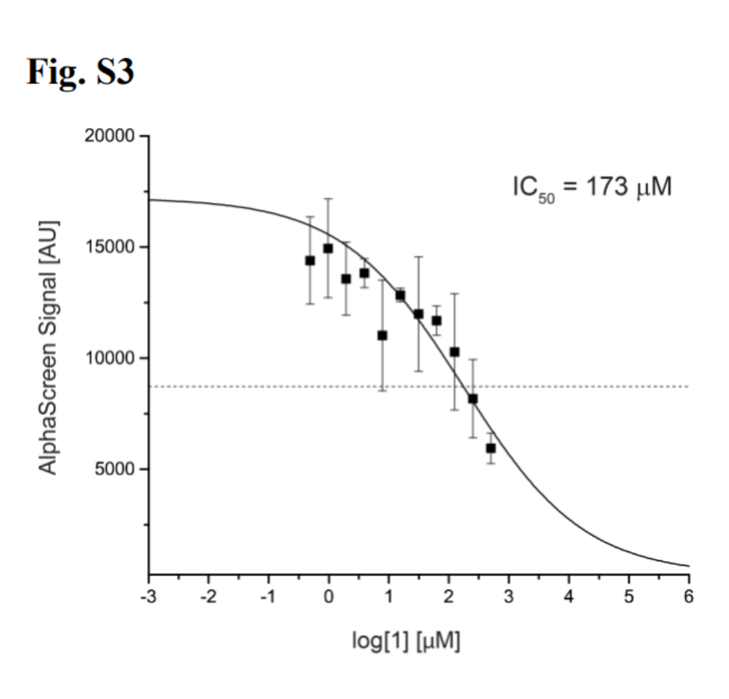
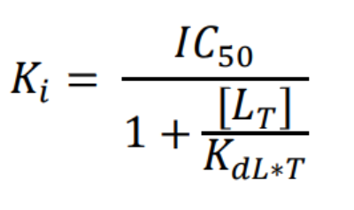
Alpha Screen results
Pex5 derivat 1
Relevant values for drug interactions
Functional strength of the inhibitor:
(IC50) The half maximal inhibitory concentration
Binding affinity:
(Ki) the inhibitory constant
LT – Protein concentration
KdL*T – apparent binding constant in the system at given peptide concentration T

Slide 14
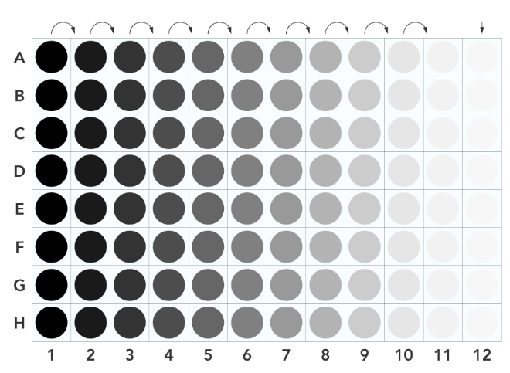
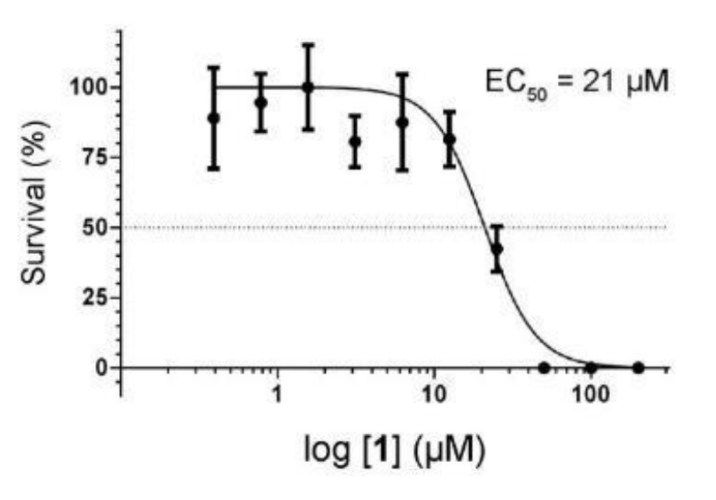
In vitro trypanocidal activity of compounds
How effective is the compound against the parasites?
Resazurin 96 wellplate Assay
Serial dilution of compound in well plate
Add same amount of cells to each well
incubated for 66 h (BSF) or 70 h (PCF)
Add resazurin (0.1 mg/ml) until 72h time point
Reduction of resazurin by living cells was quantified by measuring the fluorescence
EC50: halfmaximal effective concentration
→ More compounds NMR based fragment screen

Slide 15
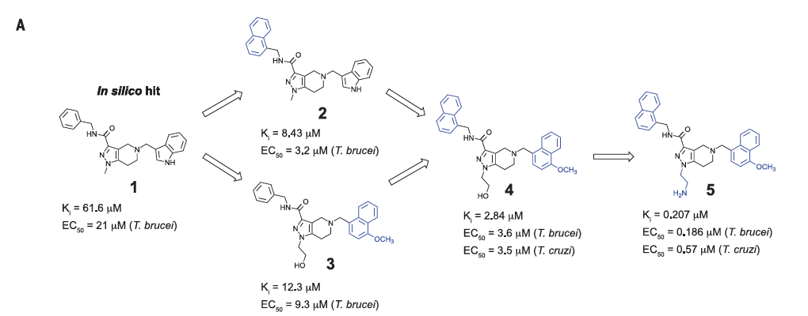
Drug optimization

Slide 16
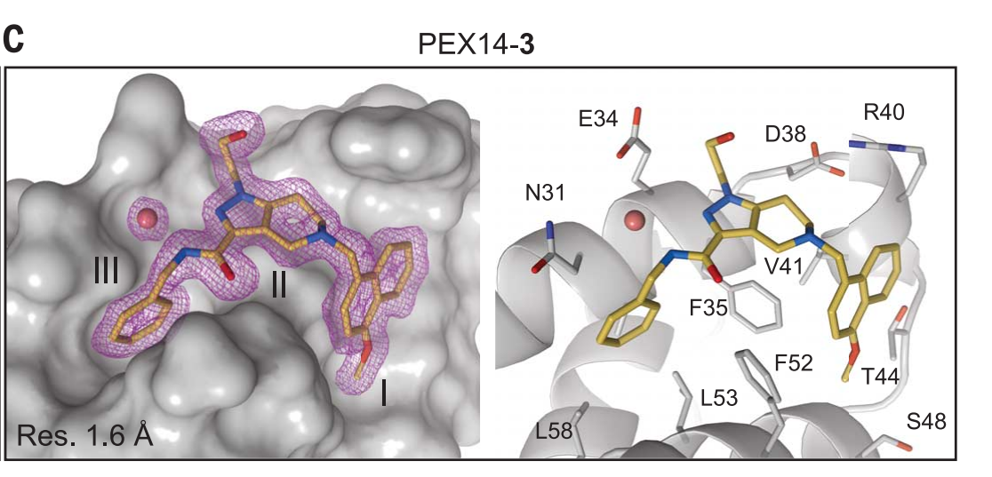
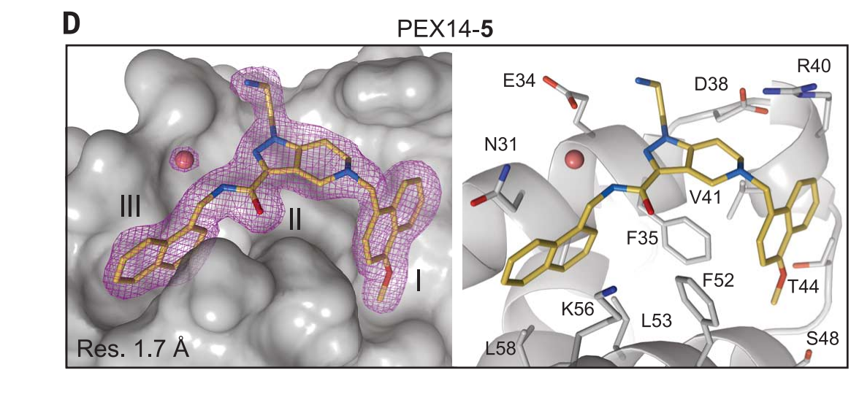
How does changing one molecular group change affinity drastically?
5-Aminogroup is near to the negatively charged carboxyl side chains of Glutamine E34
In humans: Lysine K34 (positive charge) in the way! Hspex14 Binding is blocked

Slide 17

Compound 5 is the winner!

Slide 18
pex14 as a potential Drug Target

Slide 19
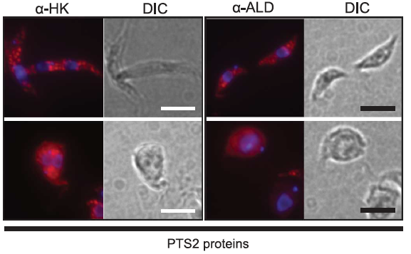
Validation in vivo: Immunofluorescence microscopy
PFK: phosphofructokinase
HK: Hexokinase
GAPDH: glycossomal glyceraldehyde 3 phosphate
ALD: aldolase
→control: granular distribution (Enzymes in Glycosomes)
+ Compound 5: Glyocomal enzymes remain in Cytoplasma

Slide 20
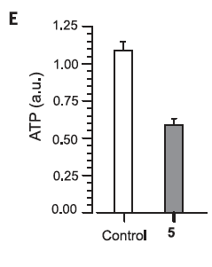
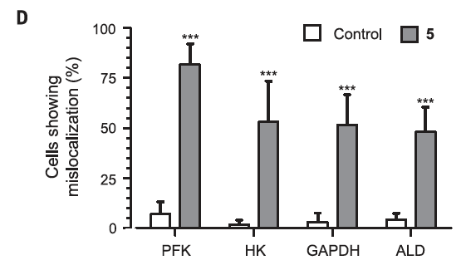
Statistical anlysis of mislocalisation
→ mislocalization of glycosomal enzymes in the presence of a sublethal concentration of derivative 5
→ 28h treatment shows ATP depletion

Slide 21
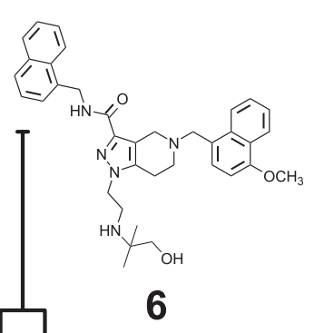
animal model
Compound 5 had no effect in mouse model!
Plasma protein binding too high! (99,4%)
Hydrophobic binding site causes unfavourable ADME values
A = Absorption
D = distribution
M = Metabolism
E = Excretion
Compound 6
Plasma protein binding 95,7%

Slide 22
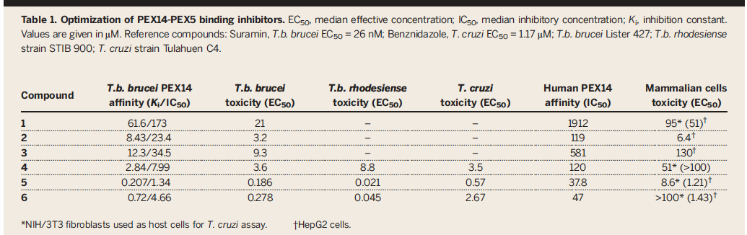
Pex5 derivates
better therapeutical fit than compound 5

Slide 23

Any questions ☺ ?

Slide 24
Video Reference
Patterns of organelle ontogeny through a cell cycle revealed by whole-cell reconstructions using 3D electron microscopy Louise Hughes1 , Samantha Borrett1 , Katie Towers1 , Tobias Starborg2 and Sue Vaughan1,*
http://www.esrf.eu/home/UsersAndScience/Publications/Highlights/highlights-2017.html/structural-biology/structure-based-development-of-small-molecules-that-disrupt-glycosomal-transport-in-trypanosoma-para.html#
https://www.google.com/search?q=questions&tbm=isch&ved=2ahUKEwiy_PGbprXpAhVaNuwKHZgIA0IQ2-cCegQIABAA&oq=questions&gs_lcp=CgNpbWcQAzICCAAyAggAMgIIADICCAAyAggAMgIIADICCAAyAggAMgIIADICCAA6BwgjEOoCECdQlg5Y1yJgjCVoAXAAeACAAYIBiAHPB5IBAzQuNZgBAKABAaoBC2d3cy13aXotaW1nsAEK&sclient=img&ei=Yz6-XvK-KdrssAeYkYyQBA&bih=802&biw=1368&rlz=1C1CHBF_deDE795DE795#imgrc=C5UUMYwKJ5i1NM&imgdii=05hJp2AJXNmn7M

