Slide 1
Kinases as Drug Targets
The Target Landscape of Clinical Kinase Drugs
Susan Klaeger, et al.
Science 358 (2017)

Slide 2
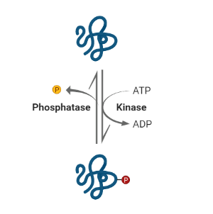

About Protein Kinases…
= enzymes regulating the biological activity of proteins by phosphorylating these
→ popular drug targets due to their frequent involvement in diseases
(e.g. inflammation or cancer)

Slide 3
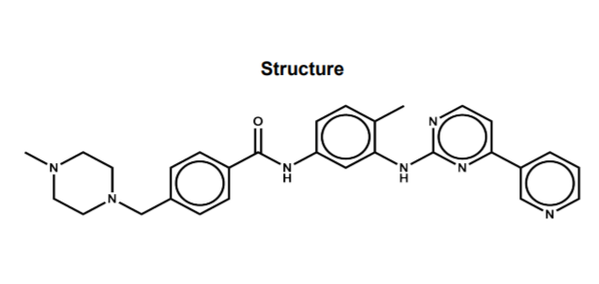
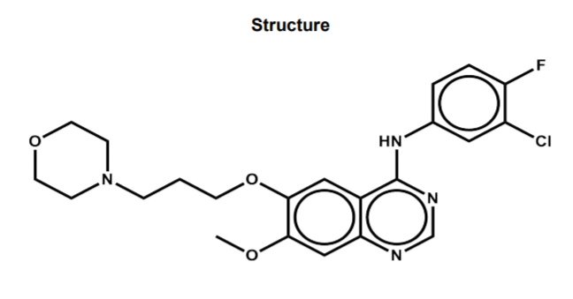
1st kinase inhibitor approval for treatment
(2003)
Imatinib
Gefitinib
= tyrosine kinase inhibitor
→ used for treatment of chronic myelogenous leukemia (CML) and acute lymphocytic leukemia (ALL)
= EGFR inhibitors
→ used for treatment of certain breast, lung and other cancers
Bhullar KS, Lagarón NO, McGowan EM, et al. Kinase-targeted cancer therapies: progress, challenges and future directions. Mol Cancer. 2018;17(1):48. Published 2018 Feb 19. doi:10.1186/s12943-018-0804-2
Structures from ProteomicsDB: https://www.proteomicsdb.org/proteomicsdb/#projects/4257

Slide 4
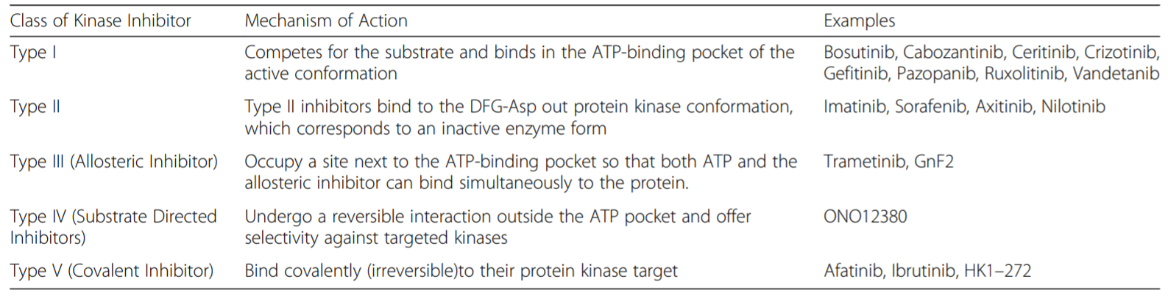
Classification of Kinase Inhibitors depending on their binding mode
Bhullar KS, Lagarón NO, McGowan EM, et al. Kinase-targeted cancer therapies: progress, challenges and future directions. Mol Cancer. 2018;17(1):48. Published 2018 Feb 19. doi:10.1186/s12943-018-0804-2

Slide 5
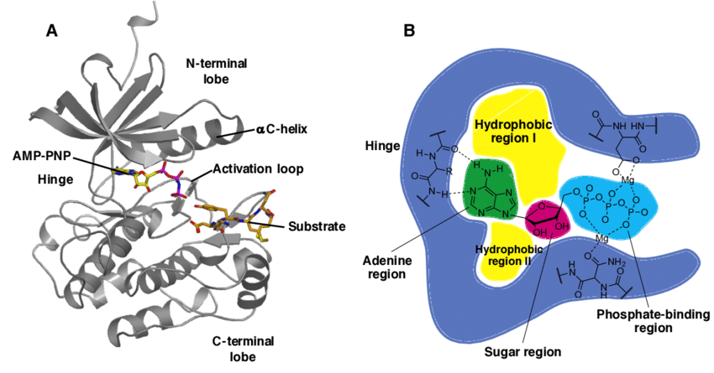
Target Structure within Kinases
Lorente-Macías, A. (2019). Structure and subregions of a typical protein kinase domain [Figure]. Retrieved from researchgate.net: https://bit.ly/3cxlP47
Some facts and numbers (in humans)
518 genes encoding for kinases (2 % of all genes)
>2,000 other purine-binding proteins
Manning, G. W. (2002, December). The Protein Kinase Complement of the Human Genome. Science, 298, pp. 1912-1934. doi:10.1126/science.1075762
ATP binding site
→ high polypharmacology

Slide 6
Problem?
for many kinase inhibitors: not much information about target space available
→ no systematic analyses so far
→ all regulating factors of the kinases cannot be captured by existing recombinant kinase assays
Lorente-Macías, A. (2019). Structure and subregions of a typical protein kinase domain [Figure]. Retrieved from researchgate.net: https://bit.ly/3cxlP47

Slide 7



Is this really a Gap?
@ time of writing:
> 110,000 publications in PubMed
> 90,000 publications & 47,000 patents in SciFinder
> 24,000 bioactivites in ChEMBL
however from investigated 243 kinase inhibitors…
... 17 had no entry at all in PubMed (4 in SciFinder)
… 35 had no listed bioactivity in ChEMBL
… 70 had less than 10 publications in PubMed (50 in SciFinder)

Slide 8


Aim of the Study
Systematic investigation of:
target space
selecitivity
full dose-response activity
of 243 clinical kinase inhibitors
Creation of open-access database containing drug profiles to faciliate translational research & drug discovery
→ demonstration of utility of such a database through different applications

Slide 9

Chemical Proteomics
  → kinobeads pulldown assay as competition binding assay
  → liquid chromatography-tandem mass spectrometry (LC-MS/MS)
Integration of Phosphoproteomic Data
  → quantitative phosphoproteomics

Slide 10
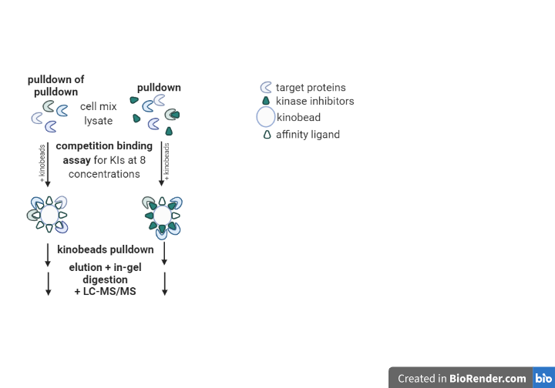
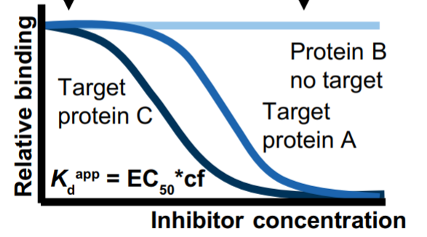
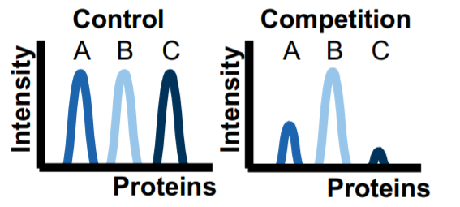
Proteomic Workflow – Pulldown
Experimental background:
K-562, COLO 205 & MV-4-11 in RPMI 1640 medium
SK-N-BE(2) cultured in DMEM/HAM‘s F-12 medium

Slide 11
The apparent Dissociation Constant K_{d}^{app}
target engagement= interaction of ligands with their target biomolecules
K_{d} = concentration of ligand at which half of the binding sites of the proteins are occupied
to determine K_{d}^{app}
EC₅₀ = half median concentration
K_{d}^{app} = EC₅₀ values corrected for the depletion of a target protein from the lysate by kinobeads (EC₅₀ * cf)
→ the smaller K_{d}^{app} (the higher pK_{d}^{app}), the higher the drug-target affinity

Slide 12
LC-MS/MS
= analytical chemistry technique combining liquid chromatography & mass spectrometry
liquid chromatography: separates mixtures with multiple components
separation power is finite
non-reliable identification
mass spectrometry: provides structural identity
+ provides confirmatory evidence of analyte
- in a mixture: confidence in identification diminishes
Dass, C. (2007). Fundamentals of Contemporary Mass Spectrometry. John Wiley & Sons, Inc. doi:https://doi.org/10.1002/9780470118498.ch5

Slide 13
Troubles
weak expression
inability to capture some
unknown binding modes (esp. members of phosphatidylinositol 3-kinase or the mammalian target of rapamycin (mTOR) family)
G-proteins

Slide 14
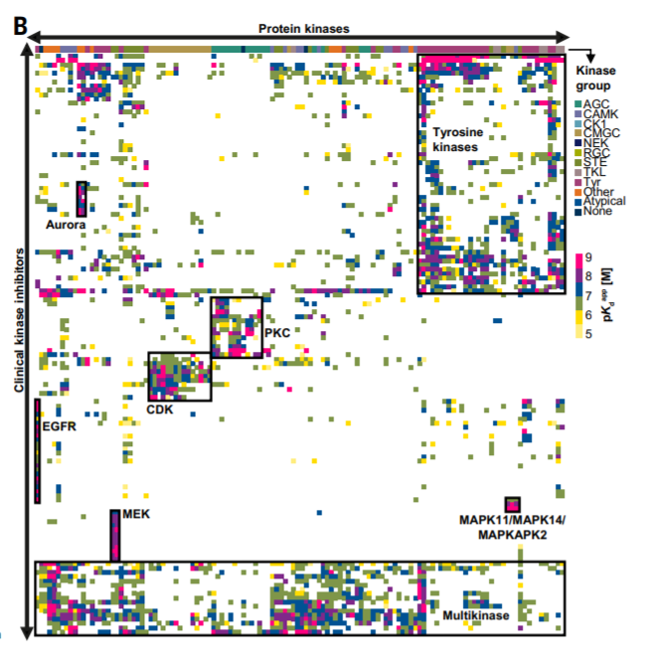
„Druggable Kinome“
clustering of kinase targets against clinical kinase drugs
→ there are groups of drugs for intended or phylogenetically related targets
→ shows selectivity of groups of kinases and inhibitors

Slide 15
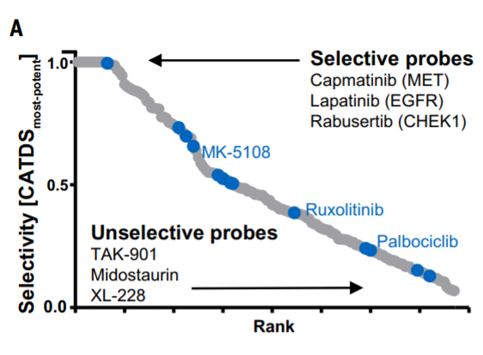
A New Selectivity Metric: CATDS concentration & target-dependent selectivity
= reduction of binding of a specific protein to kinobeads at a particular kinase inhibitor concentration relative to summed reduction of binding of all proteins at that concentration
CATDS ≈ 1 ≙ selective drug
CATDS ≈ 0 ≙ unselective drug
→ describes aspects of target engagement & drug mechanism of action
type 1 inhibitors: median CATDS of 0.3
type 2 inhibitors: median CATDS of 0.4
type 3 inhibitors: median CATDS of 0.7
in blue: probes previously classified as selective

Slide 16
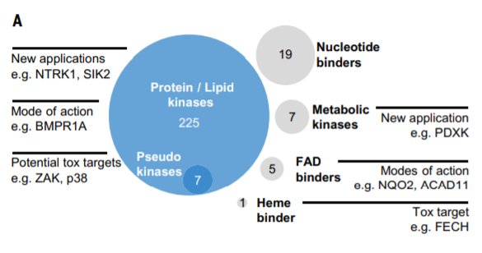
Drug Targets

Slide 17
Drug Targets – mode of action
SRC/ABL inhibitor saracatinib (undergoing clinical trials for i.a. bone cancer)
→ showed that proteins involved in bone marrow morphogenesis are high affinity targets
→ further experiments
mRNA silencing in cell lines U-2 OS & NCI/ADR-RES: drug selectivity is not exclusively due to SRC expression ⇒ BMPR signalling involved?
Western Blot: dose-dependent decrease of SMAD1/5/9 phosphorylation & SRC autophosphorylation

Slide 18
Drug Targets – repurposing drugs
NTRK1 fusion proteins= oncogenic drivers in lung, colon & brain cancer (recent discovery)
→ identified 20 new potential NTRK1 inhibitors
→ viability assay in KM12 colorectal cancer cells treated with NTRK1 inhibitors: 4 of identified inhibitors with similar potency as designated inhibitor entrecetinib

Slide 19
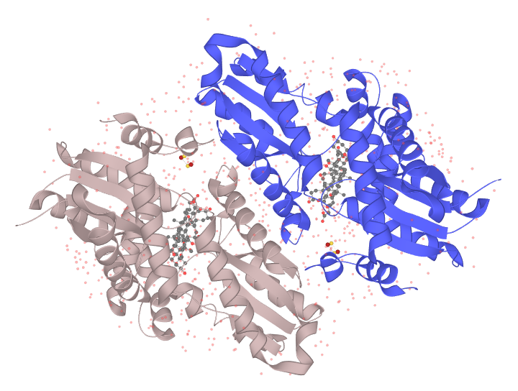
Drug Targets with negative effects
P22830 (HEMH_HUMAN) [Crystal Structure] acquired from uniprot.org: https://www.uniprot.org/uniprot/P22830
enzyme FECH
→ inhibition= responsible for photosensitivity of vemurafenib patients
→ inhibitors bind protoporphyrin-binding site
→ identified 4 additional FECH binders (30 in total)

Slide 20
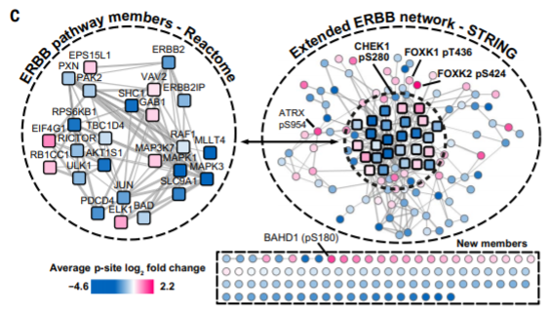
Pathway Engagement by Kinase Inhibitors
→ analysis of phosphoproteome of BT-474 cells treated with 5 EGFR/HER2 inhibitors
→ large number of regulated phosphorylation events
→ common network affected
EGFR autophosphorylation ↓
KRT8 phosphorylation ↓ (can be used for target-proximal readout for reduced EGFR activity)
MAPK1 & MAPK3 phosphorylation ↓ (proof for involvement of MAPK pathway)
CHEK1 activation

Slide 21
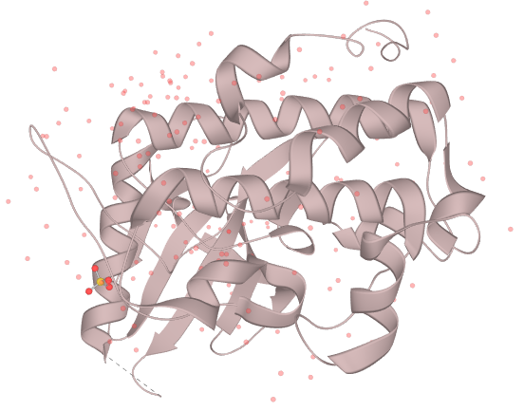
CHEK1
= serine/threonine protein kinase; plays important role in checkpoint-mediated cell-cycle arrest & activation of DNA repair mechanisms in response to DNA damage/ unreplicated DNA
→ rationalisation of combinational treatment: e.g. with highly effective CHEK1 inhibitor rabusertib
O14757 (CHK1_HUMAN) [Crystal Structure] acquired from uniprot.org: https://www.uniprot.org/uniprot/O14757

Slide 22
Overview – Systematic Profiling
offered perspective on „druggable“ kinome
revealed previously unknown targets for established drugs
highlighted (non) kinase off-targets
suggested potential therapeutic applications
refined drug-affected pathway
identified response markers
strengthened rationale for combination treatments

Slide 23

Creation of Open-Access Data Base
Exemplification of the Translational Value
→ repurposing cabozantinib to treat FLT3-ITD-positive acute myeloid leukemia

Slide 24
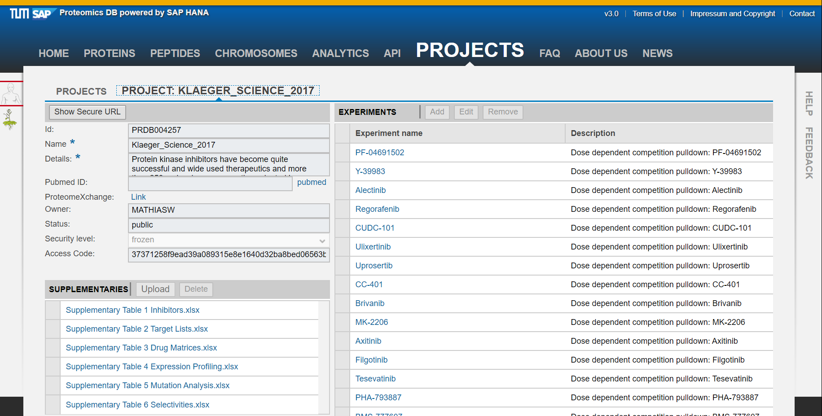

Slide 25
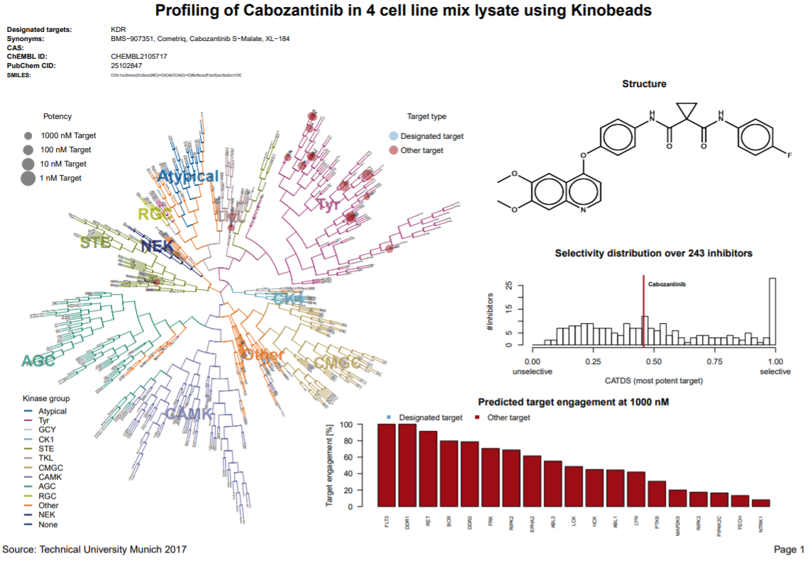

Slide 26
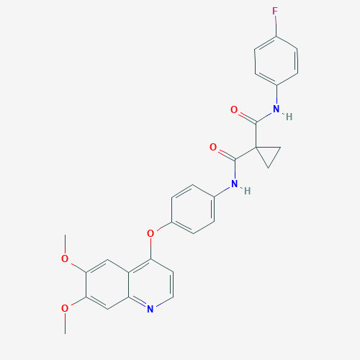
Repurposing Cabozantinib to treat FLT3-ITD-Positive Acute Myeloid Leukemia
About Cabozantinib…
= receptor tyrosine kinase inhibitor & antineoplastic agent
→ used for treatment of medullary thyroid cancer & advanced renal cell carcinoma
→ but also potent inhibitor of mutated tyrosine kinase FLT3-ITD

Slide 27
Repurposing Cabozantinib to treat FLT3-ITD-Positive Acute Myeloid Leukemia
Why is this interesting?
FLT3-ITD= mutated tyrosine kinase, involved in aggressive form of acute myeloid leukemia
experimental background:
AML cell lines were treated with cabozantinib (3 FLT3 mutant cell lines & 4 FLT3 WT cell lines)
→ only mutant cell lines were sensitive to the drug
→ immunoblotting: abrogation of STAT5 phosphorylation downstream of FLT3 at low nanomolar concentrations

Slide 28
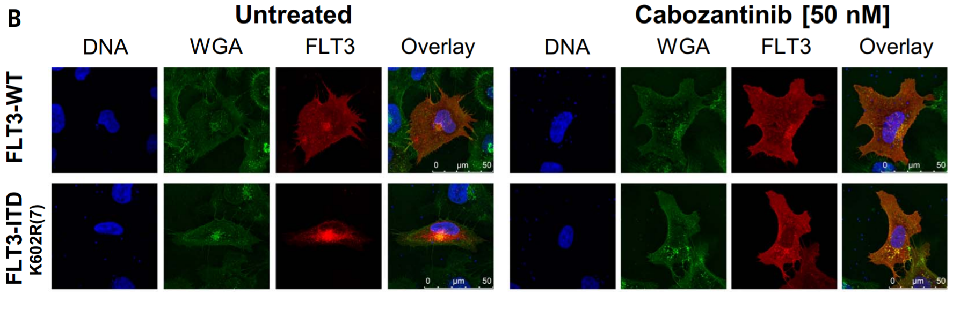
Repurposing Cabozantinib to treat FLT3-ITD-Positive Acute Myeloid Leukemia
→ immunofluorescence: FLT3-WT locates at plasma membrane, FLT3-ITD in cytosol; drug restored cellular distribution

Slide 29
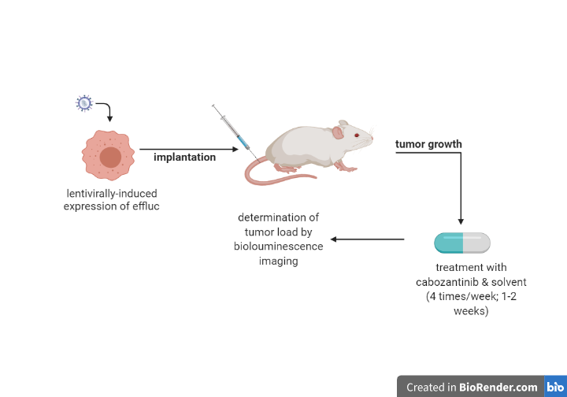
Repurposing Cabozantinib to treat FLT3-ITD-Positive Acute Myeloid Leukemia
→ xenografting mice with FLT3 mutant/ FLT3-WT cells

Slide 30
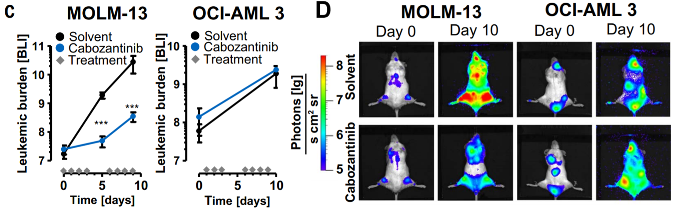
Repurposing Cabozantinib to treat FLT3-ITD-Positive Acute Myeloid Leukemia
→ human tumor xenograft (MOLM-13: FLT3 mutant cell line, OCI-AML 3: FLT3 WT cell line)
=> significant reduction of tumor burden

Slide 31

Thank you for your attention!
Do you have questions?

