Slide 1
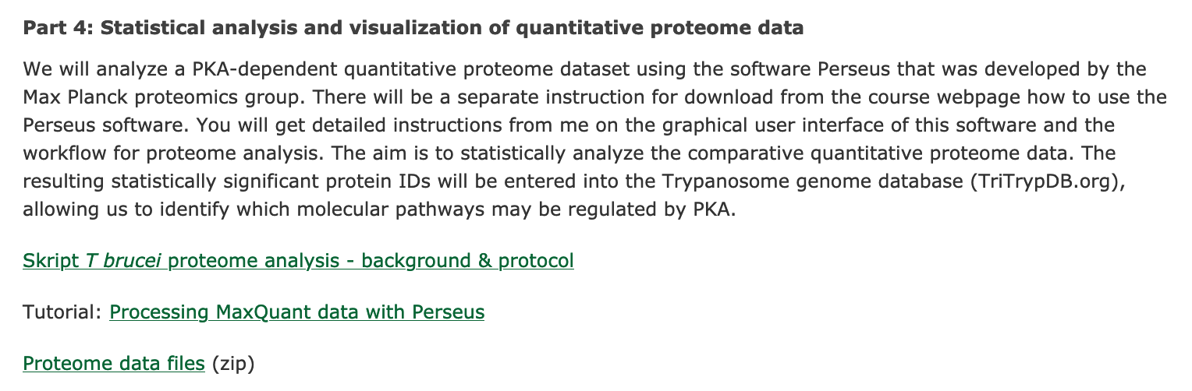

Slide 2
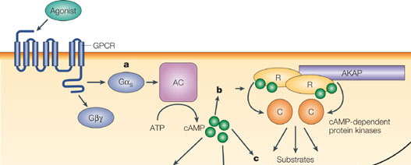
Protein Kinase A Signalling
Introduction
(modified from Wong and Scott, 2004)
2

Slide 3
Protein Kinase A
Introduction
4 x cAMP
C
R
C
R
mammalian
Free and active
R
C
R
C
2 x nucleoside(-derivative)
Free and active
R
C
C
TbPKAR
R
(Githure Ph. D. Thesis , 2014)
3

Slide 4
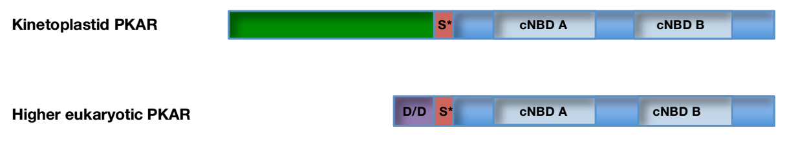
TbPKAR domains
Introduction
(Githure Ph. D. Thesis , 2014)
4

Slide 5
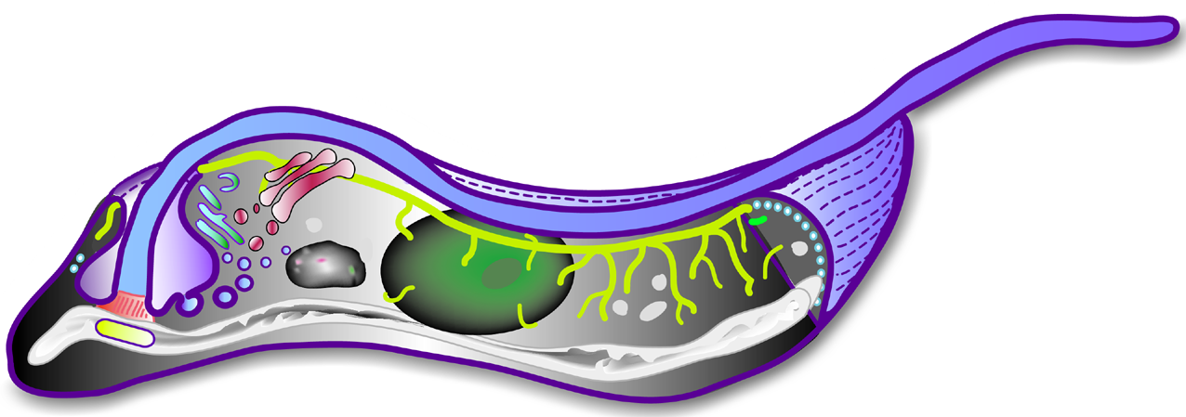
PKA localizes in the trypanosome flagellum
flagellum
flagellar pocket
nucleus
ER
kinetoplast
mitochondrion
5

Slide 6
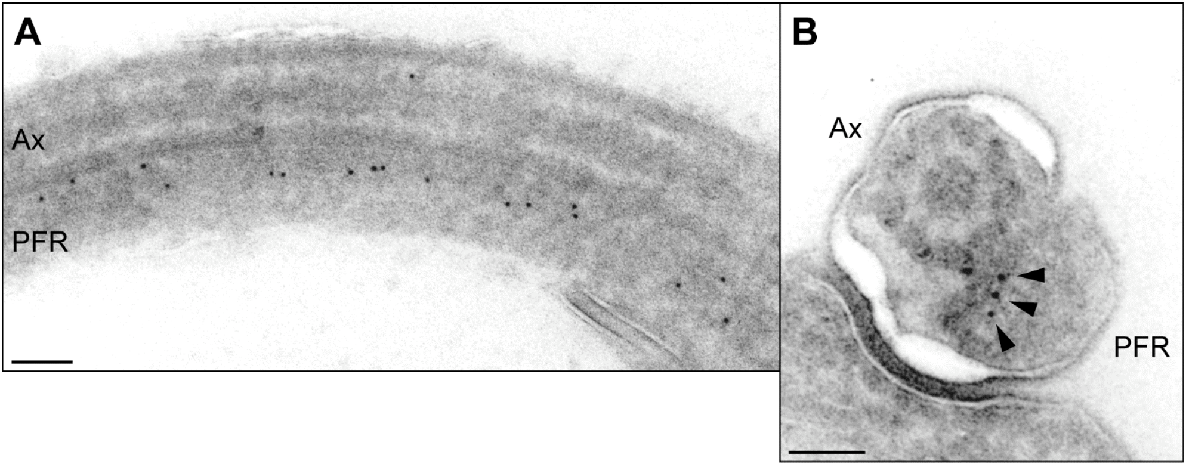
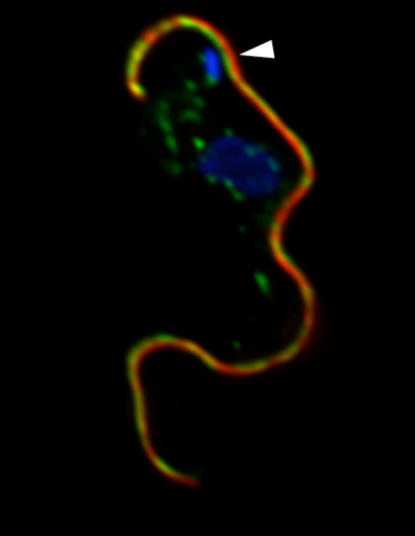
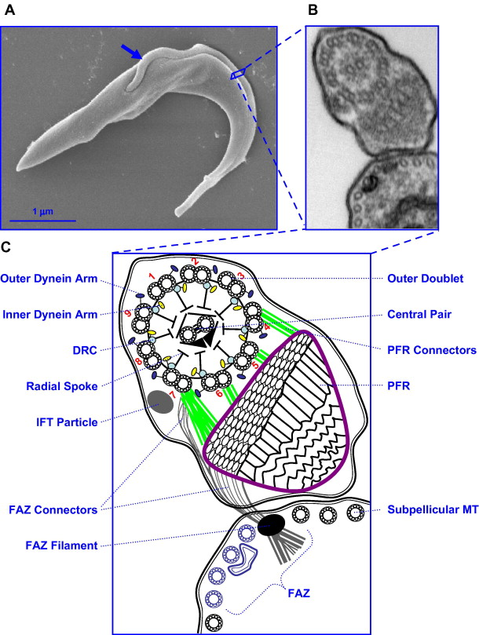
Flagellar Localization of TbPKAR
Introduction
TbPKAR
PFR
(Krumbholz Ph. D. thesis , 2006)
(Ralston et al., 2009)
6

Slide 7
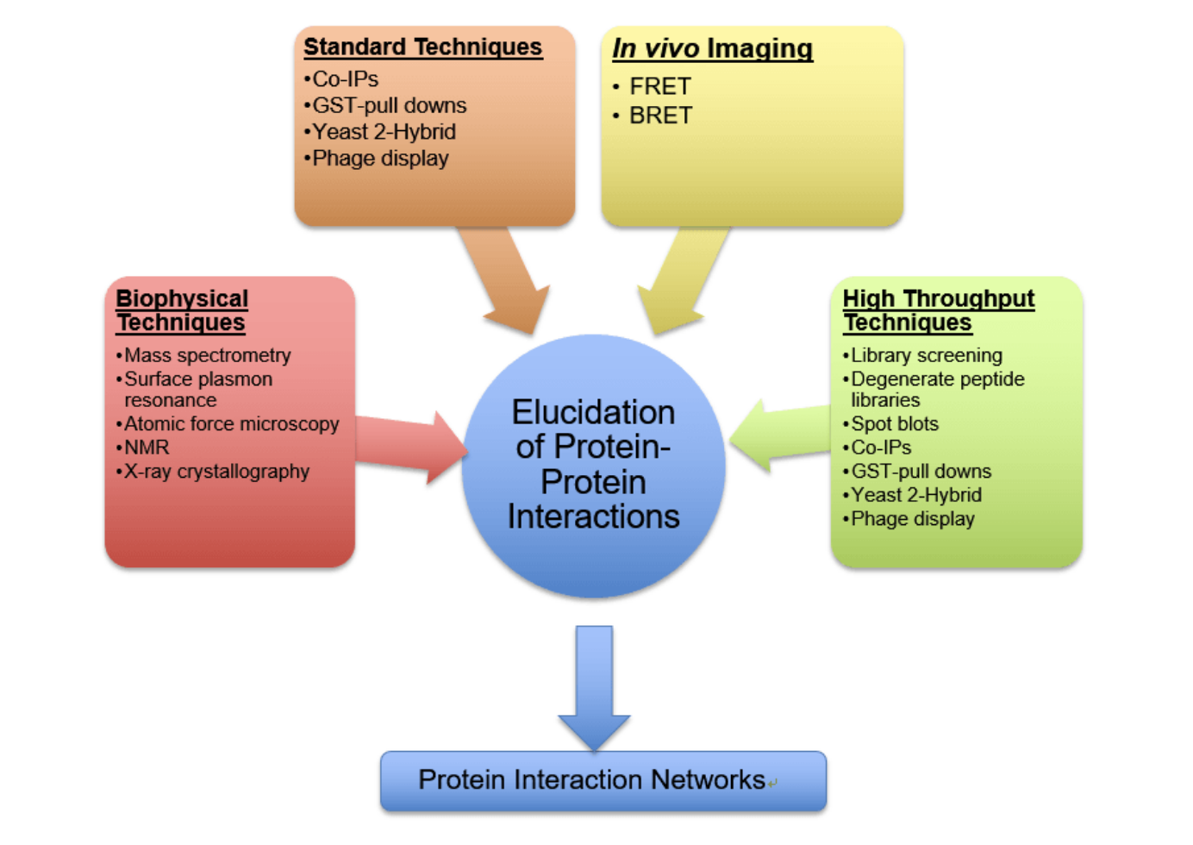
Protein-protein-interaction analysis
Introduction
7
Notes:
Yeast two-hybrid: Genome-wide screening of protein interactions by co-expression of bait with protein libraries.
Membrane-based yeast two-hybrid: Based on the split-ubiquitin protein complementation assay and detects protein interactions directly at the membrane.
Mammalian two-hybrid: Allows rapid and convenient analysis of protein-protein interactions in transfected mammalian cells.
Phage display technology: Obtain optimal protein binding by immobilization of an antigen on magnetic beads, and screening against a phage display library.
Surface plasmon resonance (SPR): The versatile label-free BIACORE technique allows detecting and monitoring of interactions in real time.
Protein array: This technique is a high-throughput method used to track the interactions and activities of proteins, and determining function on a large scale.
Co-Immunoprecipitation (CO-IP): In vivo technique that detects naturally formed protein complex.
Pull-downs: Confirm the existence of a protein-protein interaction predicted by other research techniques and identify previously unknown protein-protein interactions as an initial screening assay.
Bio-layer interferometry (BLI): Quantitative and qualitative characterization of biomolecule interactions.
CLIP-Seq technology: RNA-binding landscape mapping of interacting proteins or RNA modification sites on a genome-wide scale.
Fluorescence resonance energy transfer (FRET): Test the direct interaction in vitro of two candidate proteins, suitable for both wild type and mutant proteins.
Biomolecular fluorescence complementation (BiFC): This technique is based on the principle that two nonfluorescent fragments of a fluorescent protein dissected at appropriate site are brought together and reconstructed to fluorescence, depending on the association or interaction between the protein fused to each fragment.
Far-western blotting: This method employs non-antibody proteins to probe the protein(s) of interest on the blot.
Protein binding site mapping: Locate the binding sites with a high degree of confidence and predict the druggability of those sites.

Slide 8
Proximity proteomics
Introduction
enzyme
Identification
by MS/MS
bait
Cellular expression
enzyme
bait
Beads with high affinity to substrate
enzyme
Capture of
modified proteins
bait
substrate
8

Slide 9
Principles of BioID
Bio ID
BirA*-fusion
protein
BirA*
Identification
by MS/MS
bait
Cellular expression
BirA*
bait
streptavidin
BirA*
Capture of
biotinylated proteins
bait
Biotin
addition
9

Slide 10
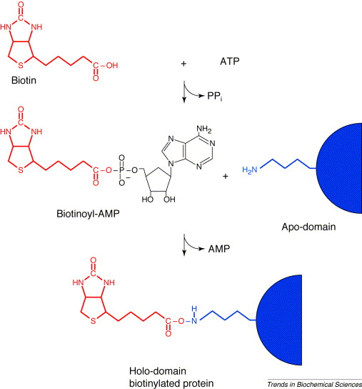
Principles of BioID
Bio ID
E. coli BirA
Release of Biotinoyl-AMP (activated)
Sequence inspecific biotinylation of Lysins
In proximity to BirA*
BirA*
Sequence specific
biotinylation
Chapman-Smith & Cronan Jr 1999, modified
10

Slide 11
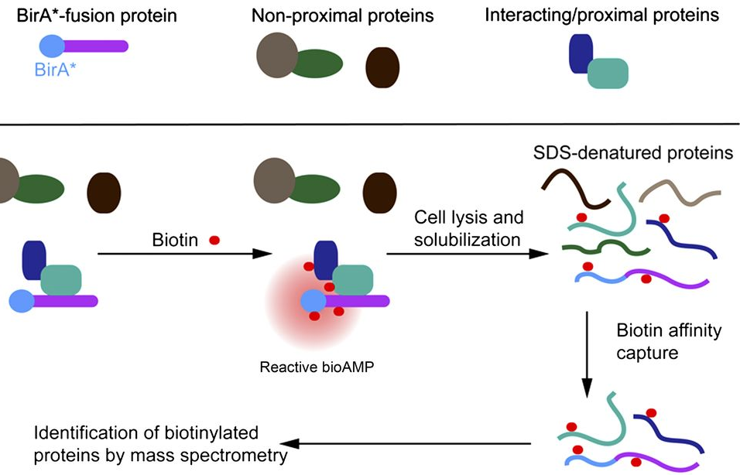
Principles of BioID
Bio ID
Roux et al. 2012
11

Slide 12
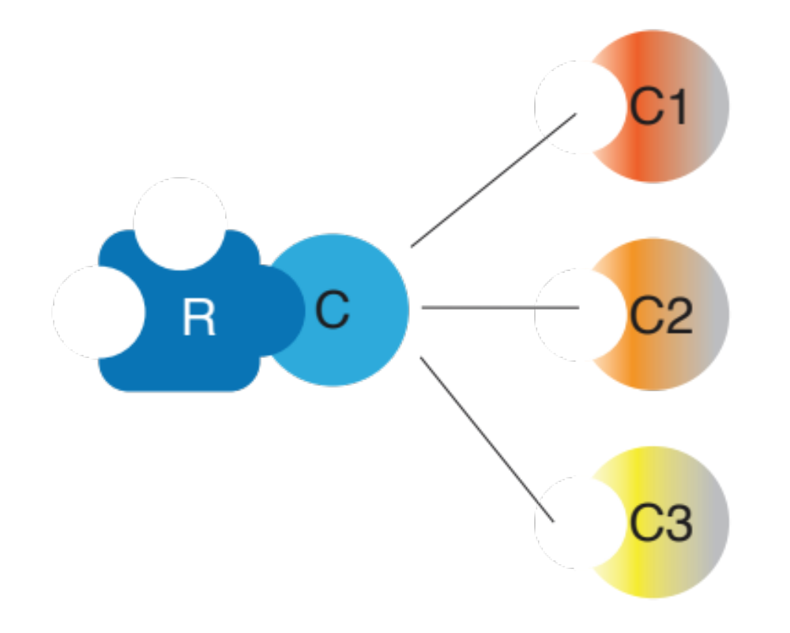
Subunits of T. brucei PKA
12

Slide 13
PKAR-BirA*, BirA*-PKAC
Approach
WT
PKAR
PKAC
PKAR-BirA*
PKAR
GS
BirA*
TY
PKAC
BirA*-PKAC
PKAR
TY
BirA*
GS
PKAC
13

Slide 14
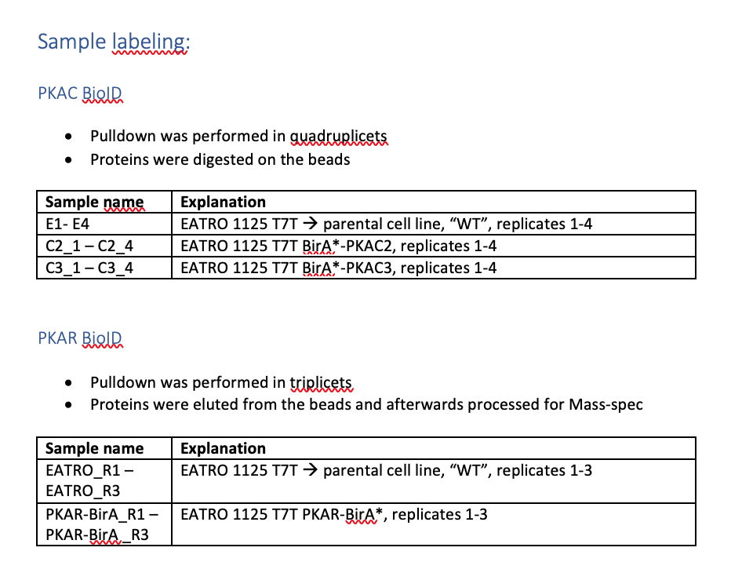
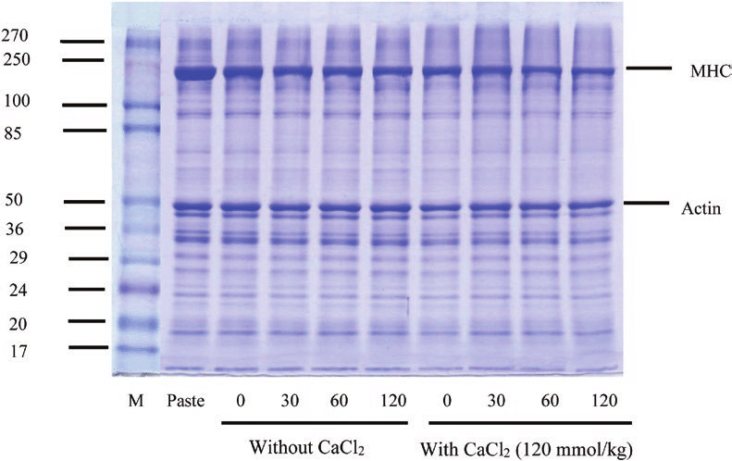
Sample processing and labeling:
PKAC BioID:
Pull-down performed in quadruplicates
On-bead digest of proteins bound to streptavidin beads
PKAR BioID:
Pull-down performed in triplicates
Detergent elution of proteins from the beads → separation by SDS PAGE and excision from gel → trypsin digest
streptavidin
On-bead digest with trypsin
Proteins eluted from the beads were separated
by SDS PAGE, excised and digested with trypsin

Slide 15
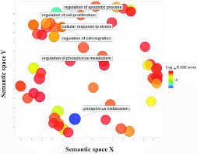
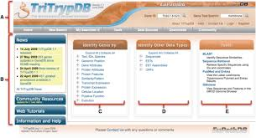

Workflow
statistical analysis of
proteome data
with Perseus
analyze significant hits
using TriTrypDB
(trypanosome genome database)
pathway enrichment analysis using ReviGO
(implemented in TriTrypDB)

