Slide 1
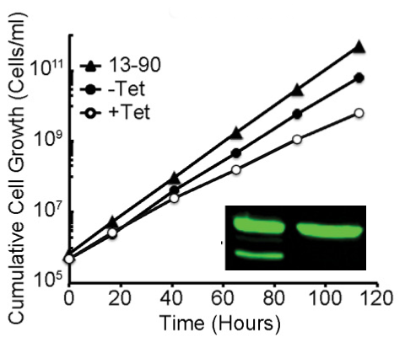
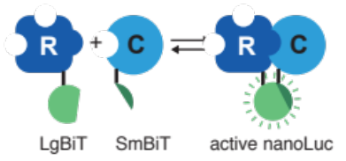

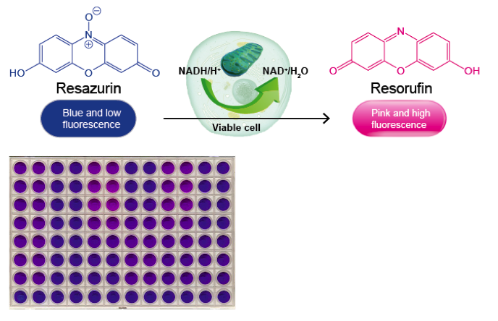
Drug target identification and validation in tropical pathogens – week 1
aim: characterize and validate T. brucei protein kinase A (PKA) as drug target
  In vivo methods
RNAi
-
+
(WT, PKA KO,
AB, mutants)
PKA
P
vs.
VASP
growth curves
& Western blot
reporter
phosphorylation
NanoBiT PKAR-C
in vivo PKA assays
cell viability assay
(mutants, drug treatment)

Slide 2
T. brucei PKA mutants
‘Wild Type‘: expresses wild type T. brucei PKAR (two alleles as trypanosomes are diploid)
‘PKAR knock out’; both alleles of PKAR have been deleted = homozygous knock out
‘PKAR add-back’: a single PKAR allele has been added back into the PKAR knock out cell line
‘PBC mutant’: a single allele of PBC mutant PKAR is expressed in the PKAR knock out cell line
‘T205A mutant: a single allele of T205 mutant PKAR is expressed in the PKAR knock out cell line
PKAR
PKAR
PKAR
PKAR
PKAR
PKAR
PKAR
PKAR
R-PBC
PKAR
PKAR
R-T205A
PKAR
Notes:
See also Script page 7

Slide 3
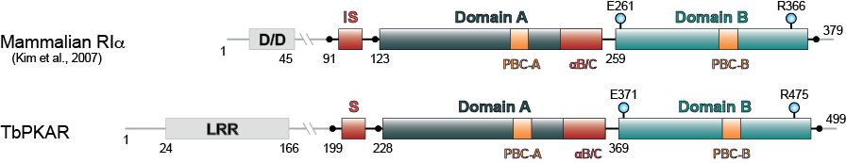
T. brucei PKA mutants
IS
...RRTT...
Notes:
See also Script page 7

Slide 4
Drug target identification and validation in tropical pathogens – week 1
aim: characterize and validate T. brucei protein kinase A (PKA) as drug target
  In vivo methods
RNAi
-
+
(WT, PKA KO,
AB, mutants)
PKA
P
vs.
VASP
growth curves
& Western blot
reporter
phosphorylation
NanoBiT PKAR-C
in vivo PKA assays
cell viability assay
(mutants, drug treatment)

Slide 5
Fill out Table 1 for each of the 5 cell lines
cell line
replicate # |  | 1 | 2 | 3
PDT logarithmic growth
growth to stationary phase | time point
 | max. density
protein expression (intensity counts normalized to PFR & WT set to 100%) | PKAR
 | PKAC1
VASP assay | % basal VASP phosphorylation
 | fold induction upon Toyo treatment
Alamar blue assay Toyo EC₅₀

Slide 6
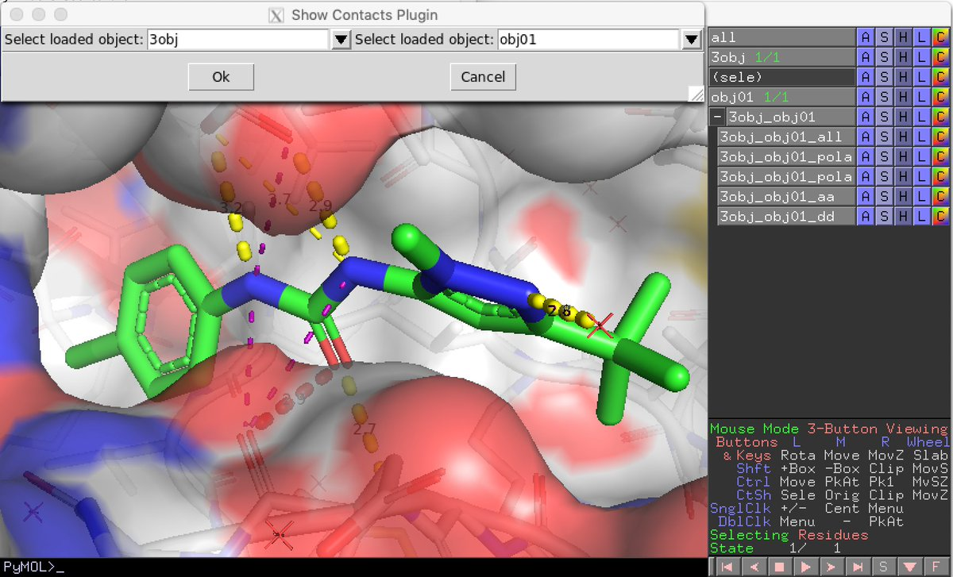
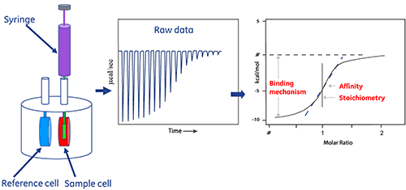
Drug target identification and validation in tropical pathogens – week 2
investigate PKAR – ligand interaction at the structural level using PyMOL
quantitatively analyze PKAR – ligand interaction in vitro by isothermal titration calorimetry (ITC)

Slide 7
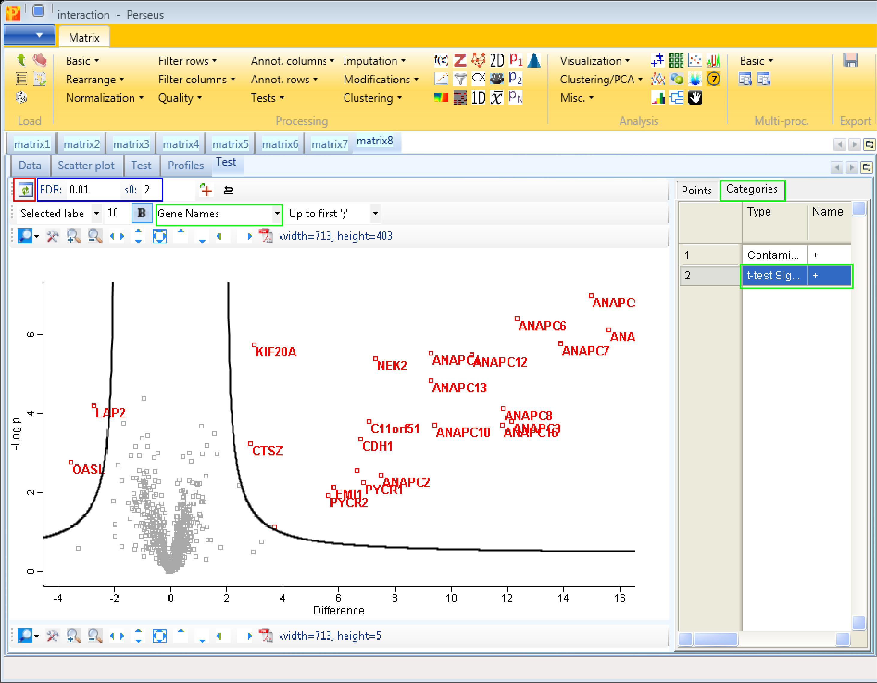
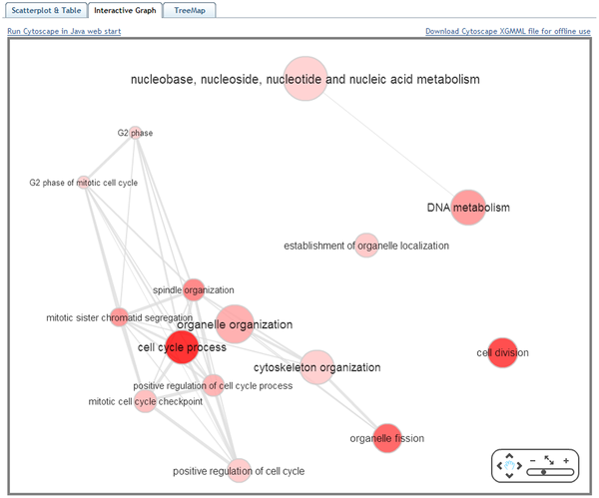
Drug target identification and validation in tropical pathogens – week 2
identify PKA interaction partners by analysis of interaction proteome data

Slide 8
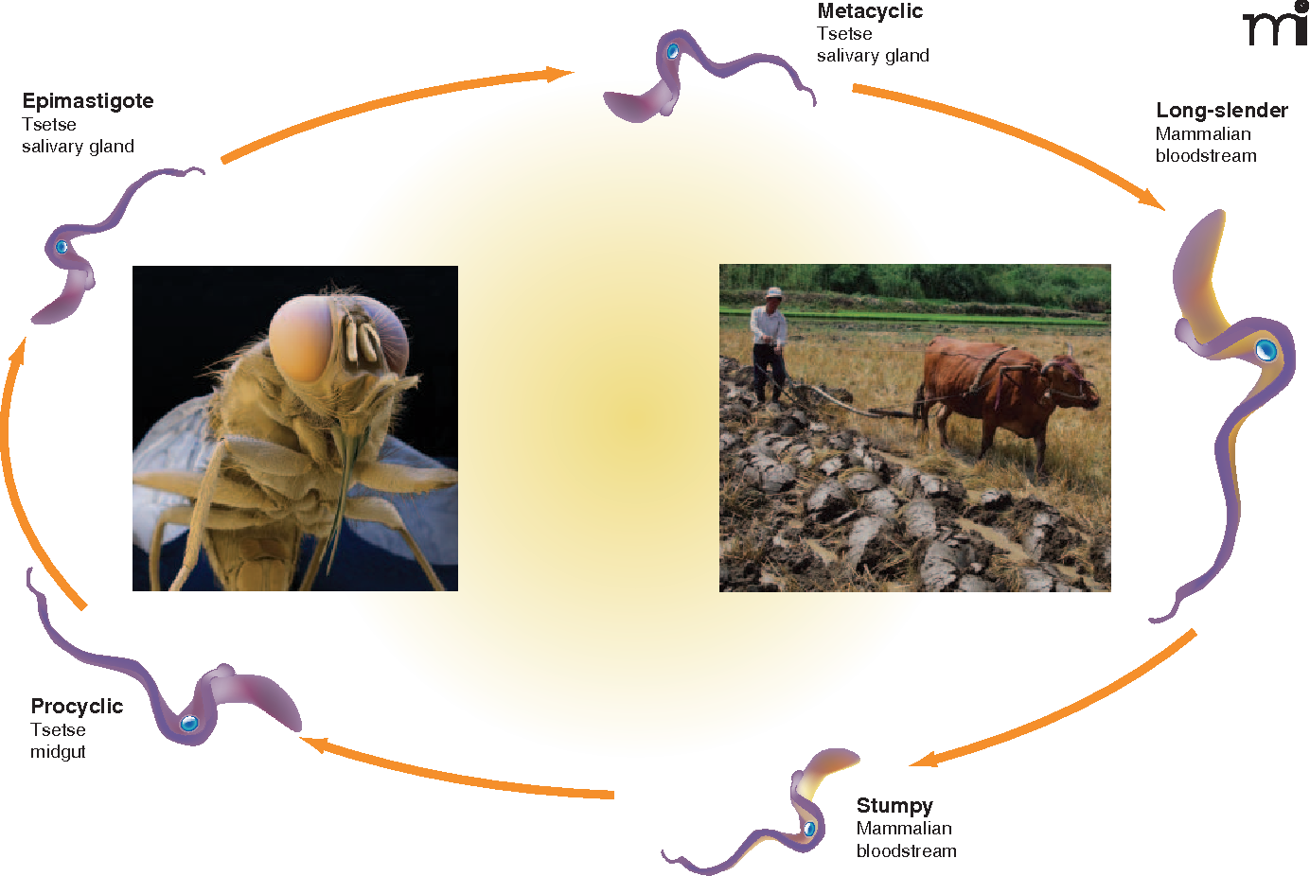
Day 1: Growth analysis of PKA mutants
Is PKAR required for proper growth of bloodstream form trypanosomes?

Slide 9

Day 1: Growth analysis of PKA mutants
Is PKAR required for proper growth of bloodstream form trypanosomes?
  Investigation of logarithmic growth at time points 0 h, 23.5 h, 47.5 h, 70 h
All 5 trypanosome cell lines were cultivated in three replicate cultures
WT
KO
AB
PBC
T205A
Cells were counted and diluted at t = 0 h, 23.5 h, 47,5 h and 70 h

Slide 10
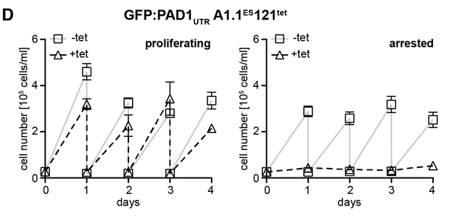
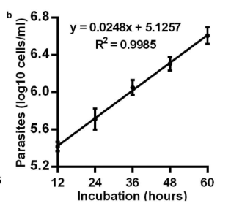
Day 1: Growth analysis of PKA mutants
Is PKAR required for proper growth of bloodstream form trypanosomes?
  Investigation of logarithmic growth at time points 0 h, 23.5 h, 47.5 h, 70 h
Non-cumulative
Cumulative

Slide 11
Day 1: Growth analysis of PKA mutants
Is PKAR required for proper stationary development of bloodstream form trypanosomes?
  Investigation of stationary growth (no dilution) at time points 0 h, 23.5 h, 47.5 h, 70 h

Slide 12
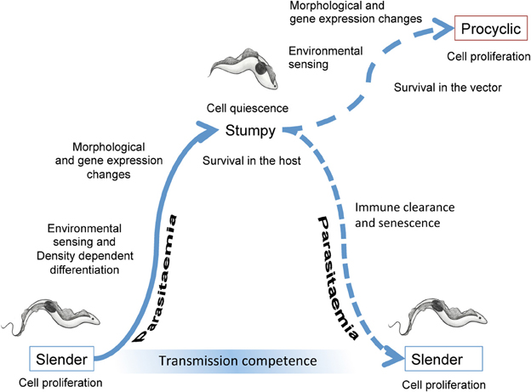
Day 1: Growth analysis of PKA mutants
Is PKAR required for proper stationary development of bloodstream form trypanosomes?
Rico et al., 2013

Slide 13
Day 1: Growth analysis of PKA mutants
Is PKAR required for proper stationary development of bloodstream form trypanosomes?
  Investigation of stationary growth (no dilution) at time points 0 h, 23.5 h, 47.5 h, 70 h
All 5 trypanosome cell lines were cultivated in three replicate cultures
WT
KO
AB
PBC
T205A
Cells were counted at t = 0 h, 23.5 h, 47,5 h and 70 h and NOT DILUTED (= stat cultures)

Slide 14
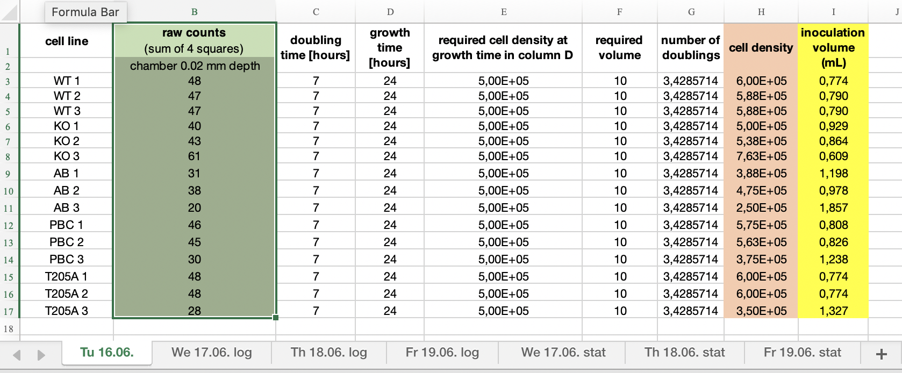
Day 1: Growth analysis of PKA mutants
Which files do you need for analysis?
  Excel file: cell count (contains raw counts of all cultures; see also Script p.10)

Slide 15
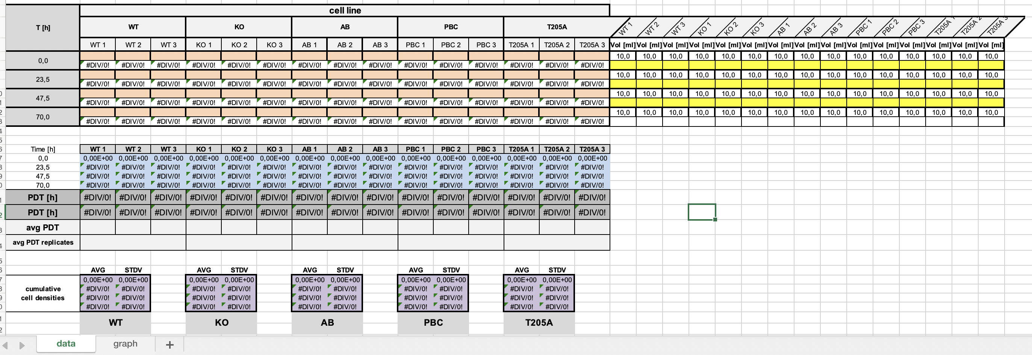
Day 1: Growth analysis of PKA mutants
Which files do you need?
  Excel file: growth curve (see also Script, p.11) → paste cell densities and inoculation volumes from Excel file ‘cell count’

Slide 16
Fill out Table 1 for each of the 5 cell lines
Which files do you need?
  Excel file: table 1 → enter values for logarithmic and stationary growth of each cell line into this table
cell line
replicate # |  | 1 | 2 | 3
PDT logarithmic growth
growth to stationary phase | time point
 | max. density
protein expression (intensity counts normalized to PFR & WT set to 100%) | PKAR
 | PKAC1
VASP assay | % basal VASP phosphorylation
 | fold induction upon Toyo treatment
Alamar blue assay Toyo EC₅₀

Slide 17

Open GraphPad Prism
We will open this software together and will do some exercises on different types of datasets
Next, we will paste the cumulative cell densities and growth times of all 5 cell lines into a new Prism file and create growth curves for logarithmic and stationary growth
Export PDFs of the growth curves for your protocol

Slide 18
Day 2

Slide 19
Drug target identification and validation in tropical pathogens – week 1
aim: characterize and validate T. brucei protein kinase A (PKA) as drug target
  In vivo methods
RNAi
-
+
(WT, PKA KO,
AB, mutants)
PKA
P
vs.
VASP
growth curves
& Western blot
reporter
phosphorylation
NanoBiT PKAR-C
in vivo PKA assays
cell viability assay
(mutants, drug treatment)

Slide 20
Practical course: Drug Target Identification – Day 2
Do PKAR mutations cause changes in PKA (PKAR/PKAC1) expression?
Do PKAR mutations influence PKA activity?

Slide 21
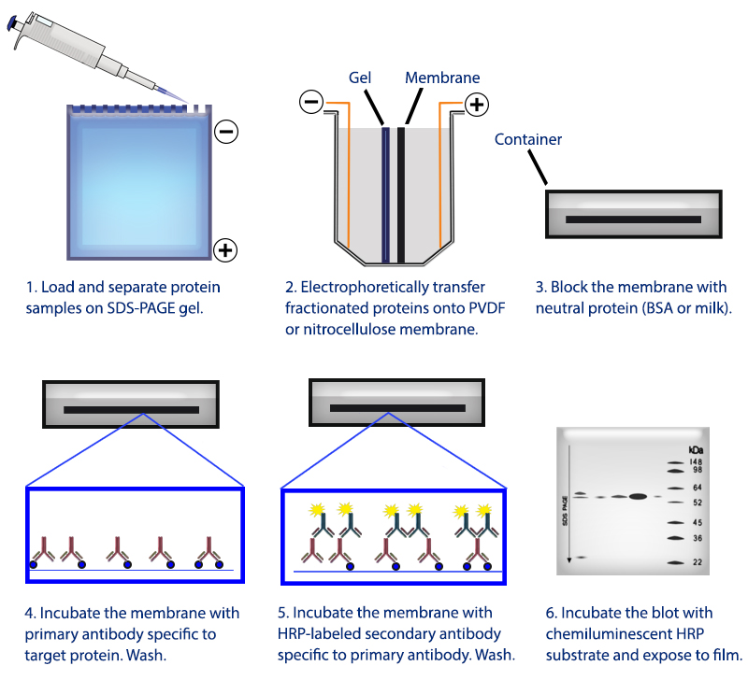
Protein expression analysis
Do PKAR mutations cause changes in PKA (PKAR/PKAC1) expression?
Western blot analysis:

Slide 22
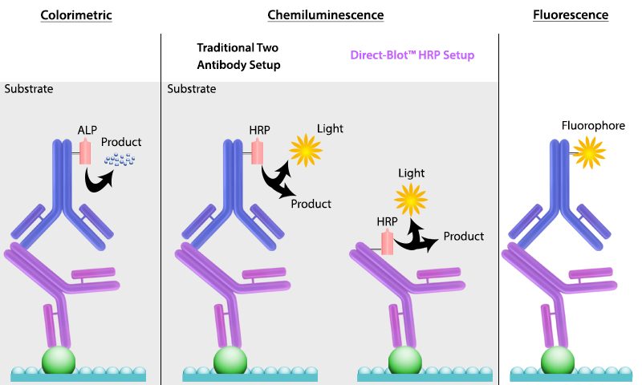
Protein expression analysis
Do PKAR mutations cause changes in PKA (PKAR/PKAC1) expression?
Western blot analysis:

Slide 23
Day 2: Protein expression analysis
Do PKAR mutations cause changes in PKA (PKAR/PKAC1) expression?
All 5 trypanosome cell lines were cultivated in three replicate cultures
WT
KO
AB
PBC
T205A
Protein lysates were prepared from all 15 cultures

Slide 24
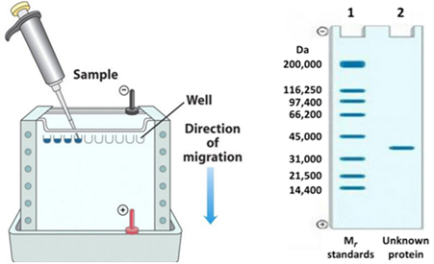
Day 2: Protein expression analysis
Do PKAR mutations cause changes in PKA (PKAR/PKAC1) expression?
M WT KO AB PBC T205A
M WT KO AB PBC T205A
M WT KO AB PBC T205A
replicate 1
replicate 2
replicate 3

Slide 25
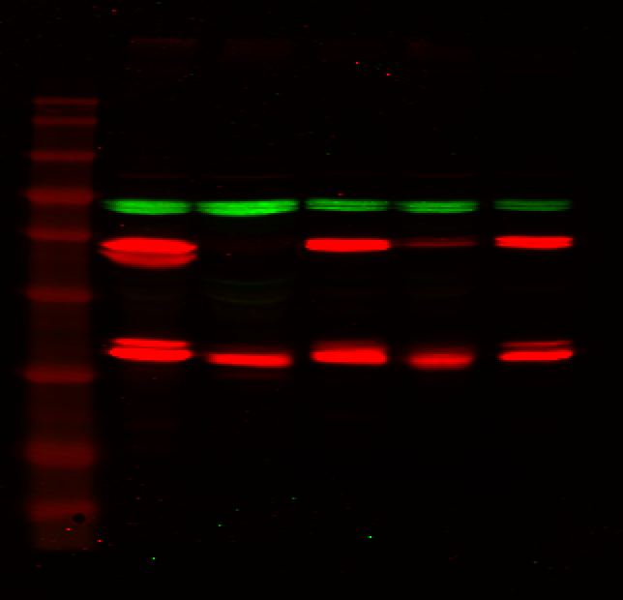
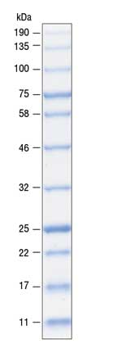
Protein expression analysis
Do PKAR mutations cause changes in PKA (PKAR/PKAC1) expression?
Western blot analysis:
M
WT KO AB PBC T205A
PFR-A/C
PKAR
PKAC1/2

Slide 26

Protein expression analysis
We will open the software ImageStudioLite together and will import the ImageStudio zip files containing the Western blot images
We will quantify all protein bands (PKAR, PKAC1/2, PFR-A/C (housekeeping gene, used for normalization) and export the quantified values as Excel file
Copy-paste the quantified expression values into GraphPad Prism (choose a column data table) and plot the mean +/- standard deviation into a column graph
Enter values into table 1

Slide 27
Fill out Table 1 for each of the 5 cell lines
cell line
replicate # |  | 1 | 2 | 3
PDT logarithmic growth
growth to stationary phase | time point
 | max. density
protein expression (intensity counts normalized to PFR & WT set to 100%) | PKAR
 | PKAC1
VASP assay | % basal VASP phosphorylation
 | fold induction upon Toyo treatment
Alamar blue assay Toyo EC₅₀

Slide 28
Protein expression analysis
Export PDFs of the Western blots and the graphs for your protocol
Interpret the results: is PKA subunit expression different between the different cell lines? Is PKAC expression dependent on PKAR? How can double bands be explained? Which impact do the mutations (PBC, T205A) have on PKA expression? Do the results match your expectations?

Slide 29
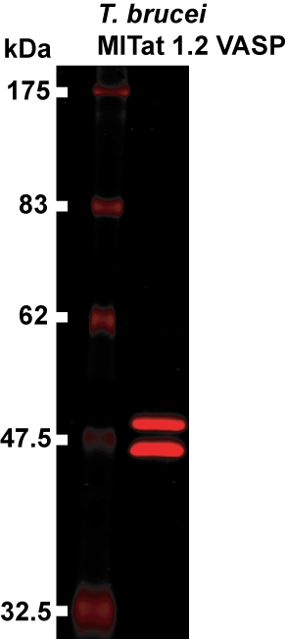
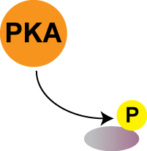
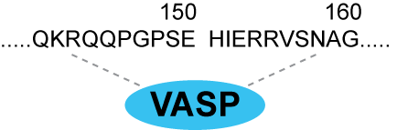
In vivo PKA kinase reporter assay
Do PKAR mutations influence PKA activity?
Expression of human VASP (PKA substrate) in T. brucei
Phosphorylation of VASP results in change of apparent molecular weight
serves as measure for PKA activity
phosphorylated
unphosphorylated

Slide 30
T. brucei PKA mutants – all cell lines express VASP protein
‘Wild Type‘: expresses wild type T. brucei PKAR (two alleles as trypanosomes are diploid)
‘PKAR knock out’; both alleles of PKAR have been deleted = homozygous knock out
‘PKAR add-back’: a single PKAR allele has been added back into the PKAR knock out cell line
‘PBC mutant’: a single allele of PBC mutant PKAR is expressed in the PKAR knock out cell line
‘T205A mutant: a single allele of T205 mutant PKAR is expressed in the PKAR knock out cell line
PKAR
PKAR
PKAR
PKAR
PKAR
PKAR
PKAR
PKAR
R-PBC
PKAR
PKAR
R-T205A
PKAR
Notes:
See also Script page 7

Slide 31
In vivo PKA kinase reporter assay
Do PKAR mutations cause changes in PKA activity?
All 5 trypanosome cell lines were cultivated in three replicate cultures
WT
KO
AB
PBC
T205A
Trypanosomes from all 15 cultures were either untreated, treated with 1% DMSO (solvent control) or with 5 µM Toyocamycin

Slide 32
In vivo PKA kinase reporter assay
Do PKAR mutations cause changes in PKA activity?
VASP assay AB
M
- DMSO Toyo - DMSO Toyo - DMSO Toyo
P-VASP
VASP
replicate 1
replicate 2
replicate 3

Slide 33
In vivo PKA kinase reporter assay
We will open the software ImageStudioLite and will import the ImageStudio zip files containing the VASP assay Western blot images
We will quantify VASP and phosphorylated VASP bands and export the quantified values as Excel file
We will analyze the data as ratiometric assay:
Relative PKA activity in % = (P-VASP/(P-VASP + VASP)) × 100
calculate the % basal VASP phosphorylation (untreated samples) and the fold change in PKA activity of treated versus DMSO control for all cell lines and replicates separately and enter values into table 1

Slide 34
Fill out Table 1 for each of the 5 cell lines
cell line
replicate # |  | 1 | 2 | 3
PDT logarithmic growth
growth to stationary phase | time point
 | max. density
protein expression (intensity counts normalized to PFR & WT set to 100%) | PKAR
 | PKAC1
VASP assay | % basal VASP phosphorylation
 | fold induction upon Toyo treatment
Alamar blue assay Toyo EC₅₀

Slide 35
In vivo PKA kinase reporter assay
Copy-paste the quantified in vivo PKA activity values into GraphPad Prism (choose a column data table) and plot the mean +/- standard deviation into a column graph
Export PDFs of the Western blots and the graphs for your protocol
Interpret the results: is PKA activity in absence of treatment different between the different cell lines? Is PKA activation by toyocamycin different between the different cell lines? Which impact do the mutations (PBC, T205A) have on PKA activity? Do the results match your expectations?

Slide 36
Day 3

Slide 37
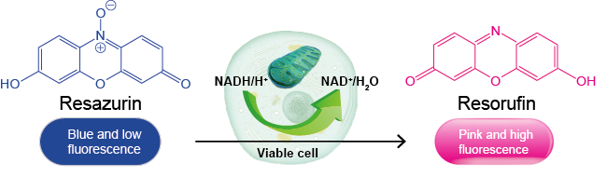
Viability Assays

Slide 38
Viability & Cytotoxicity Assays
measure viability of a cell or organism quantitatively
distinguishes between live and dead cells/organisms
detection of dead cells = cytotoxicity assay
detection of live cells = viability assay

Slide 39
Viability Assays
based on measurement of diverse cellular functions, e.g.
  membrane permeability (e.g. dye uptake assays)
  mitochondrial activity (ATP production, redox potential)
  enzyme activity (e.g. proteases/caspases)
  coenzyme production
  nucleotide uptake
  motility
  osmotic stability
  etc.

Slide 40
Assay read-out
colorimetric (absorption measurement with photometer / plate reader)
fluorometric (absorption measurement with photometer / plate reader; flow cytometer; microscope)
luminometric (luminescence measurement with photometer / luminometer / plate reader)

Slide 41
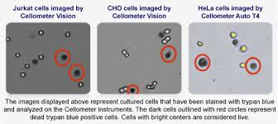
Dye Exclusion Assay
often used: trypan blue (remember: kills trypanosomes!)
staining of dead cells only
live cells are not stained as dye is not membrane-permeable

Slide 42
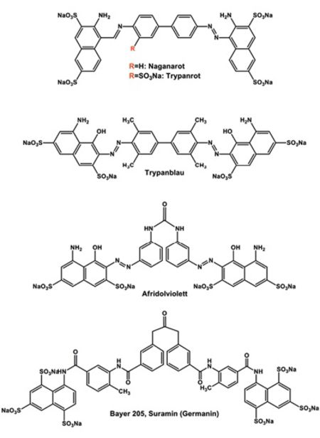

Slide 43
Measurement of redox potential
reducing equivalents such as NADH or FADH₂ are required for oxidative phosphorylation in the mitochondrial respiratory chain to drive ATP production
redox potential (amount of NAHd & FADH₂) is high in living cells and decreases in dying cells
often used: Alamar Blue assay
reduction of resazurin to resorufin
* cheap * very sensitive * suitable for HTS * combinable

Slide 44
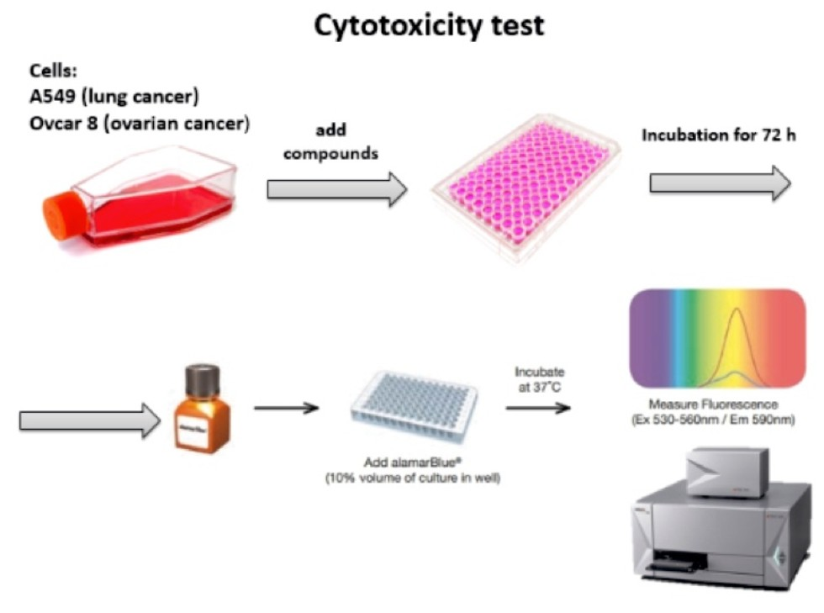
Cell viability assay
Trypanosoma brucei
bloodstream forms
resazurin

Slide 45
Day 4: Alamar blue cell viability assay
Do PKAR mutations cause changes in sensitivity to toyocamycin?
All 5 trypanosome cell lines were cultivated as single cultures
WT
KO
AB
PBC
T205A
The Alamar blue assay was set up with technical triplicates for each cell line according to the following scheme:

Slide 46
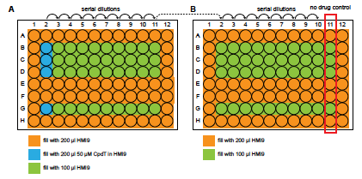
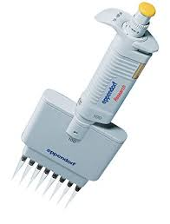
Day 4: Alamar blue cell viability assay
Do PKAR mutations cause changes in sensitivity to toyocamycin?
replicate 1
replicate 2
replicate 3
no cells control

Slide 47
Day 4: Alamar blue cell viability assay
Trypanosoma brucei
bloodstream forms
resazurin

Slide 48
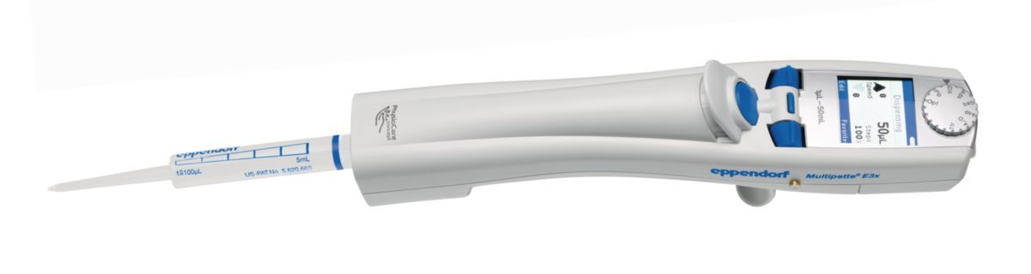
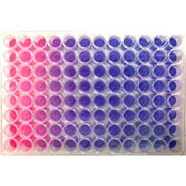
Day 4: Alamar blue cell viability assay

Slide 49
Day 4: Alamar blue cell viability assay
open the Excel workbook ‚AlamarBlue_Toyocamycin‘ and copy the log₁₀ M Toyocamycin concentrations and the % survival into a new GraphPad Prism file (XY data table & graph with mean +/- SD)
analyze the data by non-linear regression analysis (-> Analyze -> XY analyses -> Nonlinear regression (curve fit) -> OK -> Dose-response inhibition -> log(inhibitor) vs. response – variable slope (four parameters) -> OK)
→ a new results sheet will appear in Prism that shows you the IC₅₀ value
→ a curve resulting from the non-linear regression will appear in the chart
Enter IC₅₀ values into table 1

Slide 50
Fill out Table 1 for each of the 5 cell lines
cell line
replicate # |  | 1 | 2 | 3
PDT logarithmic growth
growth to stationary phase | time point
 | max. density
protein expression (intensity counts normalized to PFR & WT set to 100%) | PKAR
 | PKAC1
VASP assay | % basal VASP phosphorylation
 | fold induction upon Toyo treatment
Alamar blue assay Toyo EC₅₀

Slide 51
Alamar blue cell viability assay
Export PDFs of the graphs for your protocol
Interpret the results: do you observe differences in sensitivity to Toyocamycin between the different cell lines? Do PKAR mutations have an impact on sensitivity to Toyocamycin? Do the results match your expectations?

Slide 52
Alamar blue cell viability assay
repeat the procedure with the ‚AlamarBlue_trypan_blue‘ Excel file (only wild type and knock out were included in this assay) and determine whether PKAR may be involved in conferring sensitivity to trypan blue

