Slide 1
PROTEIN-PROTEIN INTERACTIONS
Seminar: Drug Target Identification in Tropical Pathogens
MARTA ALCALÁ REY

Slide 2
INDEX
Structural biology of protein-protein interactions and classification into different types.
  Role of structural biology.
  Key characteristics of protein-protein interactions.
  Classifying of protein-protein interactions.

Slide 3
INDEX
Strategies for identifying protein-protein interactions inhibitors.
  High-throughput screening.
  Fragment screening and optimization.
    Biophysical methods for fragment-based drug discovery.
  Rational design: peptides and peptidomimetics.
  Computational approches.
  Lead optimization.

Slide 4
Role of Structural Biology
Structural biology is often central to protein-protein interaction research. It might be preferable to have access to a structure of the complete protein-protein interaction to inform a drug discovery effort by Xray crystallography or NMR spec­troscopy.
Department of Life Sciences, Centre for Integrative Systems Biology and Bioinformatics, Imperial College London, London, United Kingdom

Slide 5
Key Characteristics of Protein-Protein Interaction
A critical development in the understanding of protein-protein interactions was the realization that certain residues or regions, termed hot spots, are largely responsible for driving binding. This can be explored experimentally by a process known as alanine scanning or hot­spot analysis.
Department of Life Sciences, Centre for Integrative Systems Biology and Bioinformatics, Imperial College London, London, United Kingdom

Slide 6
Key Characteristics of Protein-Protein Interaction
Analysis of alanine scanning data indicates a preference for Trp, Tyr and Arg as hot­spot residues. The polar residues Asp and His are also enriched. It has been proposed that hot spots inter­act cooperatively and tend to be distributed within tightly packed local clusters.
Department of Life Sciences, Centre for Integrative Systems Biology and Bioinformatics, Imperial College London, London, United Kingdom

Slide 7
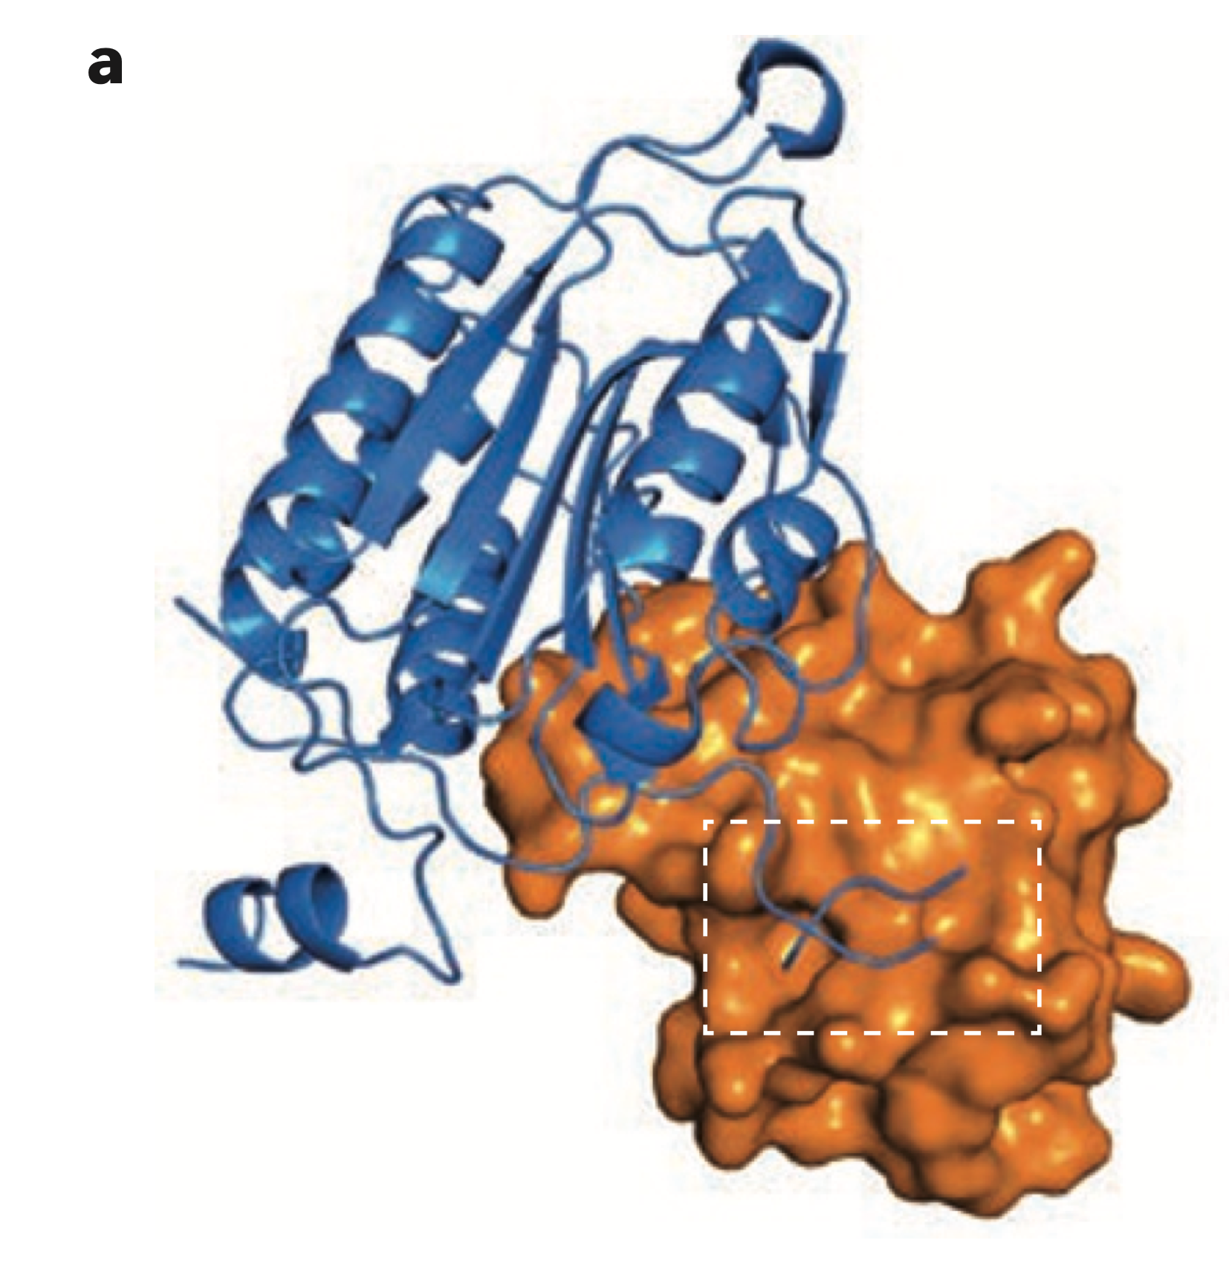
Classifying of Protein-Protein Interactions
Homomeric Vs. Heteromeric.
Obligate (strong and long lived) Vs. Non-­obligate (weaker and transient).
Small molecules, big targets: drug discovery faces the protein– protein interaction challenge Duncan E. Scott¹, Andrew R. Bayly^{1,2}, Chris Abell¹ and John Skidmore³

Slide 8
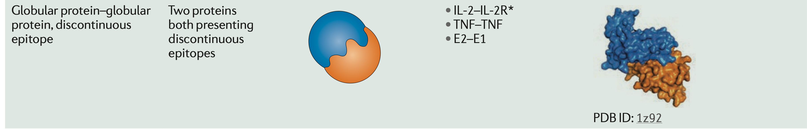
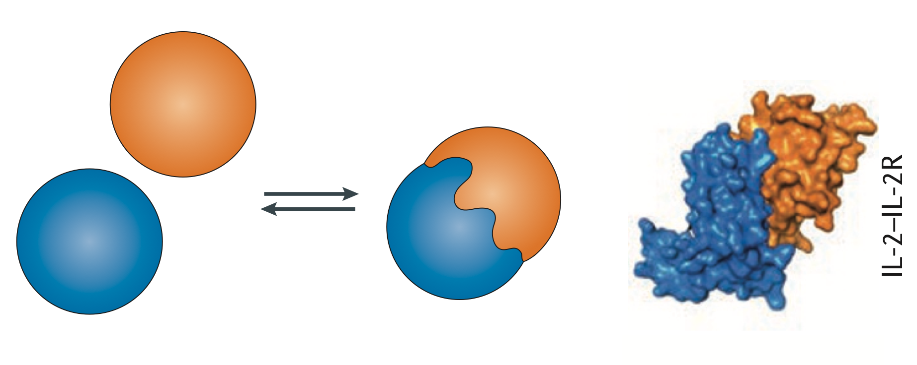
Classifying of Protein-Protein Interactions
Globular protein-Globular protein, discotinuous epitope.
Small molecules, big targets: drug discovery faces the protein– protein interaction challenge Duncan E. Scott¹, Andrew R. Bayly^{1,2}, Chris Abell¹ and John Skidmore³

Slide 9
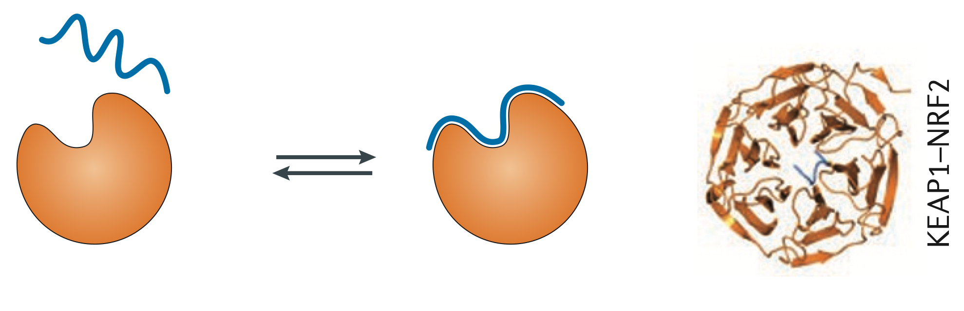
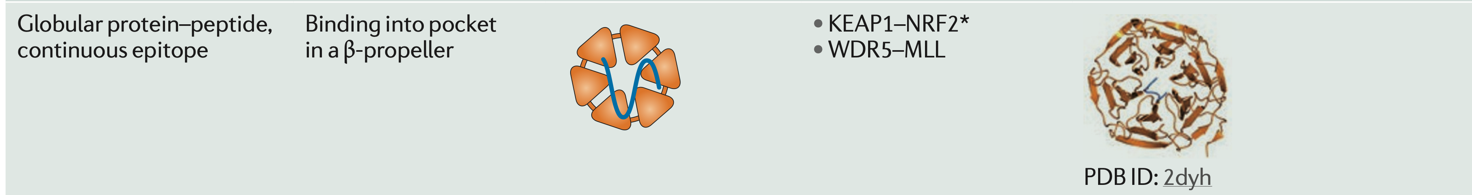
Classifying of Protein-Protein Interactions
Globular protein-Peptide, continuous epitope.
Small molecules, big targets: drug discovery faces the protein– protein interaction challenge Duncan E. Scott¹, Andrew R. Bayly^{1,2}, Chris Abell¹ and John Skidmore³

Slide 10
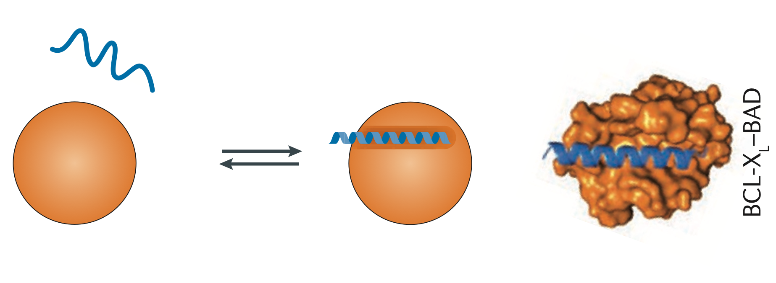
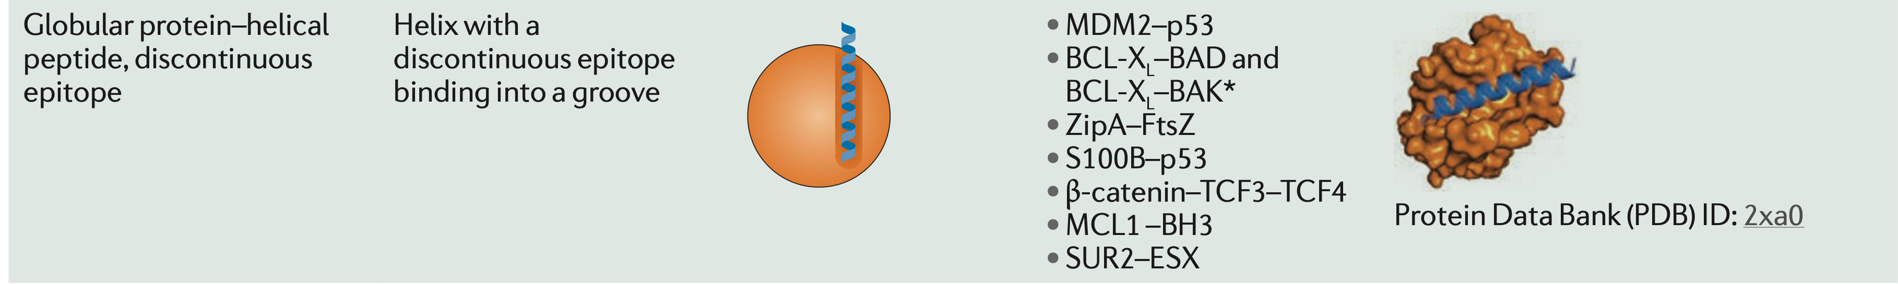
Classifying of Protein-Protein Interactions
Globular protein-Helical peptide, discontinuos epitope.
Small molecules, big targets: drug discovery faces the protein– protein interaction challenge Duncan E. Scott¹, Andrew R. Bayly^{1,2}, Chris Abell¹ and John Skidmore³

Slide 11
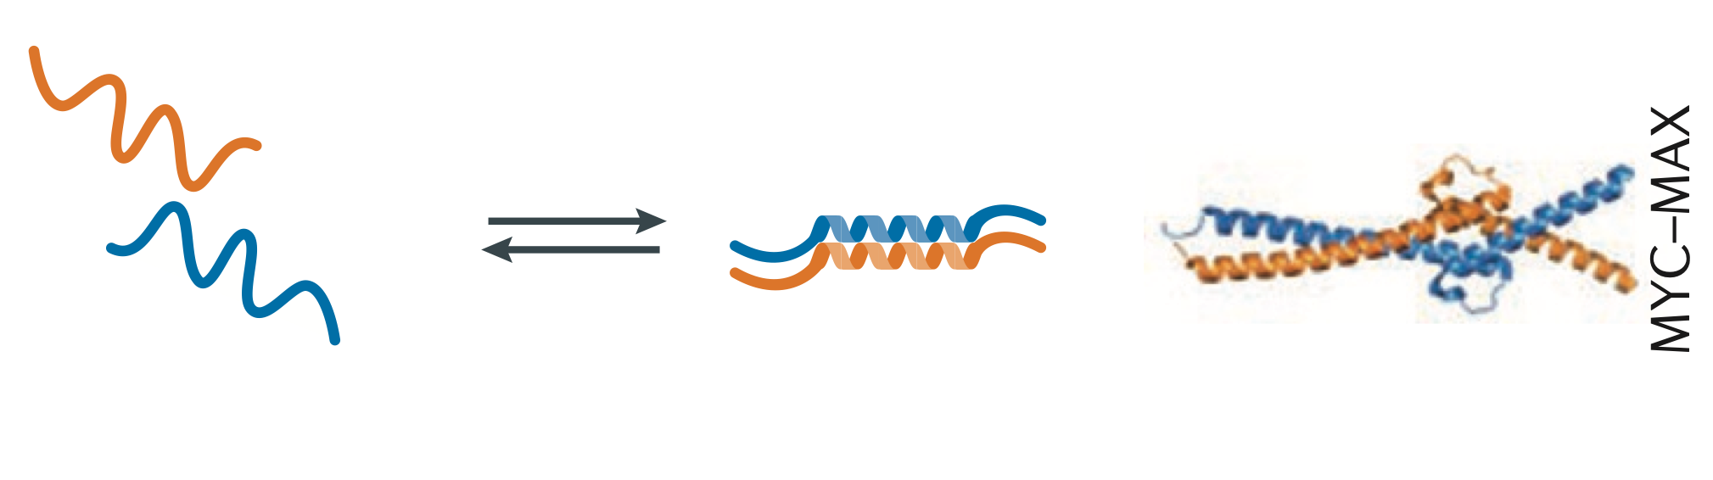
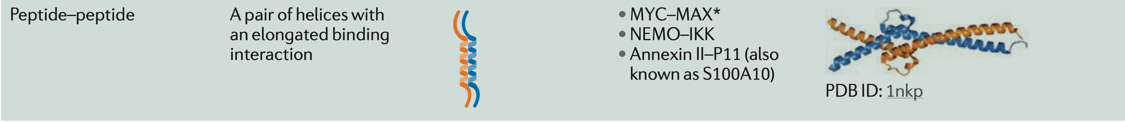
Classifying of Protein-Protein Interactions
Peptide-Peptide.
Small molecules, big targets: drug discovery faces the protein– protein interaction challenge Duncan E. Scott¹, Andrew R. Bayly^{1,2}, Chris Abell¹ and John Skidmore³

Slide 12
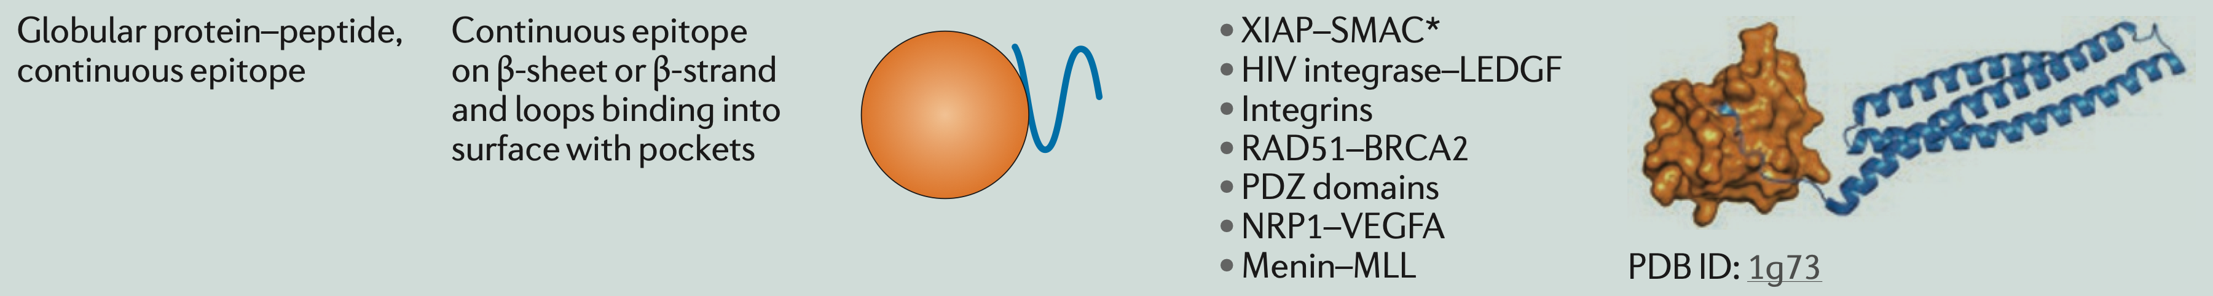
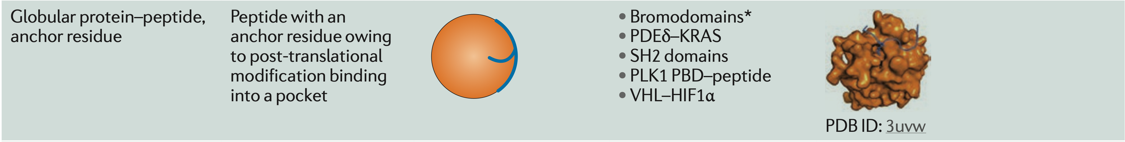
Classifying of Protein-Protein Interactions
Globular protein-Peptide.
Small molecules, big targets: drug discovery faces the protein– protein interaction challenge Duncan E. Scott¹, Andrew R. Bayly^{1,2}, Chris Abell¹ and John Skidmore³

Slide 13
INDEX
Structural biology of protein-protein interactions and classification into different types.
  Role of structural biology.
  Key characteristics of protein-protein interactions.
  Classifying of protein-protein interactions.

Slide 14
INDEX
Strategies for identifying protein-protein interactions inhibitors.
  High-throughput screening.
  Fragment screening and optimization.
    Biophysical methods for fragment-based drug discovery.
  Rational design: peptides and peptidomimetics.
  Computational approches.
  Lead optimization.

Slide 15
High-throughput Screening
High­ throughput screening has been suc­cessfully applied, particularly to the identification of molecules mimicking a non­continuous epitope consisting of side chains on an α­helix. Screening strategies have also been successfully applied to find natural product inhibitors.

Slide 16
Fragment Screening and Optimization
Fragment ­based drug discovery (FBDD) has been shown to be particularly effective against targets, such as protein-protein interactions, that are generally viewed as ‘undruggable’. It has been shown that there is a good correlation between hot­spot regions of a protein and fragment­ binding sites.
Small molecules, big targets: drug discovery faces the protein– protein interaction challenge Duncan E. Scott¹, Andrew R. Bayly^{1,2}, Chris Abell¹ and John Skidmore³

Slide 17
Biophysical Methods for Fragment-Based Drug Discovery
Thermal Shift (TS).
The stabilization that is associated with the binding of a ligand to a protein leads to an increase in the unfolding temperature of the protein, which can be detected by heating the protein in the presence of a dye sensitive to protein denaturation.
https://www.sygnaturediscovery.com/drug-discovery/bioscience/biophysical-assays/cellular-thermal-shift-assay-cetsa/

Slide 18
Biophysical Methods for Fragment-Based Drug Discovery
Surface Plasmon Resonance (SPR).
Method that detects changes in the refractive index of a surface layer caused by binding events, enabling the measurement of ligand affinities and in some cases the determination of binding kinetics.
https://www.researchgate.net/figure/SPR-detection-principle-When-surface-plasmon-resonance-occurs-a-dip-in-the-reflected_fig20_323879942

Slide 19
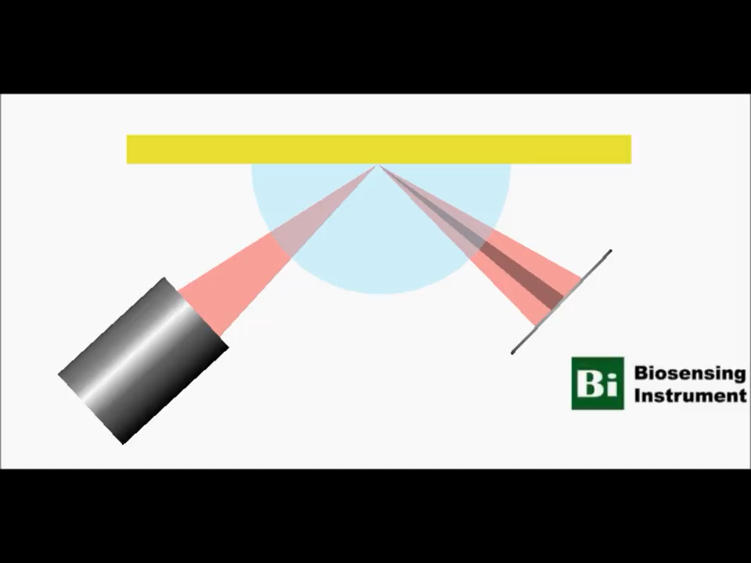

Slide 20
Biophysical Methods for Fragment-Based Drug Discovery
Ligand- or Protein-Based Nuclear Magnetic Resonance (NMR).
Ligand binding is detected through changes in the NMR signals.
https://www.theresonance.com/fragment-screening-by-ligand-observed-nmr/

Slide 21
Biophysical Methods for Fragment-Based Drug Discovery
X-Ray Crystallography.
Used to determine the structure of ligands bound to proteins.
https://www.creativebiomart.net/resource/principle-protocol-x-ray-crystallography-393.htm
https://medium.com/@macromoltek/what-is-x-ray-crystallography-1e186bc3d180

Slide 22
Biophysical Methods for Fragment-Based Drug Discovery
Isothermal Titration Calorimetry.
The heat associated with the binding of a ligand to a protein is measured and used to determine both the dissociation constant and potentially the thermodynamics of binding.
https://www.researchgate.net/figure/Basic-principle-of-isothermal-titration-calorimetry-Schematic-representation-of-the_fig4_282834104

Slide 23


Slide 24
Rational Design: Peptides and Peptidomimetics
Much design work has been based on the rational design of general scaffolds that mimic the three major recognition motifs found to modulate protein-protein interactions: α­helices, β­strands and reverse ­turns.
Boger and colleagues designed a polyamide scaffold that represents the i, i+4 and i+7 residues; improved ease of synthesis allowed facile creation of an 8,000 ­member library of mimetics for in vitro screening.
Design and Application of an α‐Helix‐Mimetic Scaffold Based on an Oligoamide‐Foldamer Strategy: Antagonism of the Bak BH3/Bcl‐xL Complex Justin T. Ernst Jorge Becerril Hyung Soon Park Dr. Hang Yin Andrew D. Hamilton Prof. (2003)

Slide 25
Rational Design: Peptides and Peptidomimetics
Developing mimetics of continuous epitopes, such as β­strands and turns, and of short peptide sequences with no clear secondary structure presents a very dif­ferent challenge. Mimics of β­strands are less prevalent, probably owing to these secondary structure motifs making few hydrophobic interactions.

Slide 26
Computational Approaches
Given the structure of a protein-protein interaction it is possible to use compu­tational tools to assess druggability and identify possible small­ molecule binding pockets.
Dr. PIAS is a software tool that identifies similarities in pocket structure from a database of known PPI inhibitors and targets. The ANCHOR system for identifying ‘anchoring’ residues that are deeply buried upon binding.

Slide 27
Lead Optimization
Once the binding site of a ligand moves beyond established hot spots it can be difficult to derive substantial potency from additional interactions, which can make optimization of leads into potential drug candidates highly demanding. The problem is most pronounced for cases in which the binding surface is relatively flat and featureless.

Slide 28
Outlook

Slide 29
1. Bajorath, J. Integration of virtual and high-throughput screening. Nat Rev Drug Discov 1, 882–894 (2002).
2. Duncan E. Scott1, Andrew R. Bayly1,2, Chris Abell1 and John Skidmore3 . Small molecules, big targets: drug discovery faces the protein– protein interaction challenge Duncan E. Scott1, Andrew R. Bayly1,2, Chris Abell1 and John Skidmore3 .
3. Erlanson D.A. (2011) Introduction to Fragment-Based Drug Discovery. In: Davies T., Hyvönen M. (eds) Fragment-Based Drug Discovery and X-Ray Crystallography. Topics in Current Chemistry, vol 317. Springer, Berlin, Heidelberg.
4. Gregory A. Weiss, Colin K. Watanabe, Alan Zhong, Audrey Goddard, and Sachdev S. Sidhu. Rapid mapping of protein functional epitopes by combinatorial alanine scanning.
creening. Nat Rev Drug Discov 1, 882–894 (2002).
5. Justin T. Ernst Jorge Becerril Hyung Soon Park Dr. Hang Yin Andrew D. Hamilton Prof.. Design and Application of an α‐Helix‐Mimetic Scaffold Based on an Oligoamide‐Foldamer Strategy: Antagonism of the Bak BH3/Bcl‐xL Complex.

Slide 30
Thanks for your attention

