Slide 1
RENAISSANCE OF ALLOSTERY TO DISRUPT PROTEIN KINASE INTERACTIONS
Alejandro E. Leroux1 and Ricardo M. BiondI
January 2020
DRUG TARGET INDENTIFICATION IN TROPICAL PATHOGENS
- SRUTHI RAMESH

Slide 2
PROTEIN KINASE
Enzymes that modifies proteins through phosphorylation .
Mostly acts on free hydroxyl group - serine , threonine and tyrosine.
They are involved in a wide range of pathological conditions such as cancer, inflammatory diseases, diabetes, infectious diseases, cardiovascular disorders and cell growth.
They are the second most important group of drug targets, after G-protein-coupled receptors.
Trypanosomatids have an abundance of STE and CMGC family protein kinases.
Naula et al., 2005

Slide 3
What is allostery ?
Mechanism by which an interaction at one site of a protein (allosteric or regulatory site) produces a conformational change that affects the function of a second, distant site (active site).
Bidirectional communication between the regulatory site and the active site in protein kinases
Leroux and Biondi, 2020

Slide 4
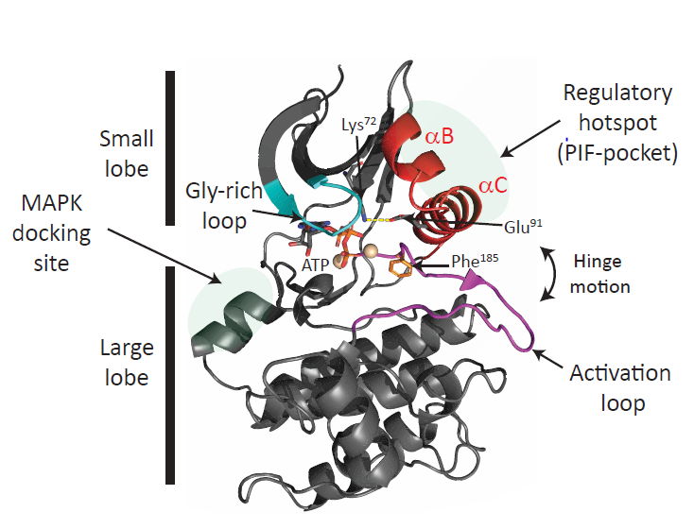
PROTEIN KINASE CATALYTIC DOMAIN
Large lobe
Small lobe with regulatory hotspot (β-sheet, αB and α C helices).
Active site – ATP binding site and activation loop.
DFG is a conserved Asp-Phe-Gly tripeptide motif at the proximal end of the activation loop.
Leroux and Biondi, 2020

Slide 5
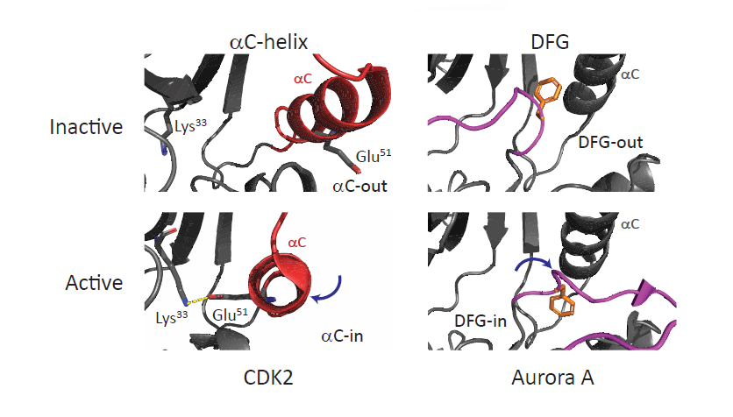
Active and inactive states
Leroux and Biondi, 2020

Slide 6
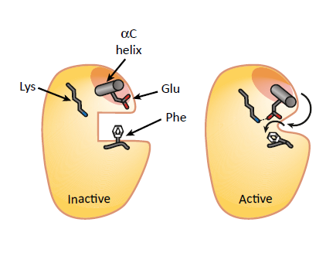
Glu residue on the αC helix, Lys residue on the β3 sheet, and Phe from the DFG-motif
Leroux and Biondi, 2020

Slide 7
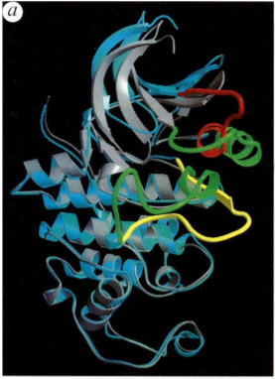
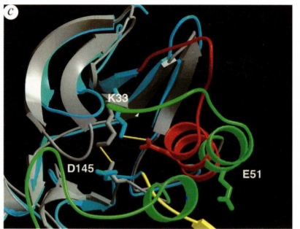
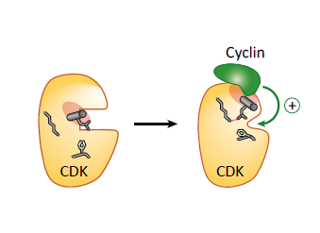
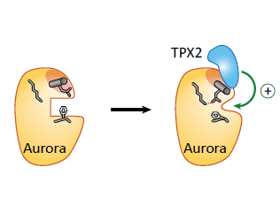
Allosteric Regulation:
Regulatory hotspot to active site
CDK and Cyclin
Aurora A and TPX2
Inactive : Lys 33 and Asp 145
Active : Lys 33 and Glu 51
Leroux and Biondi, 2020 & Jeffrey et al., 1995

Slide 8
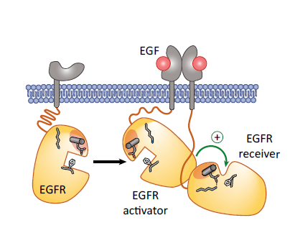
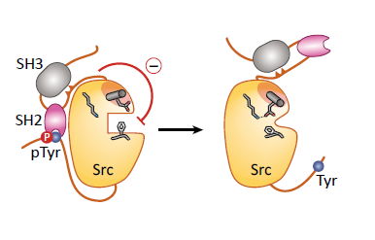
EGF and EGFR
SRC Kinase and SH domains
Leroux and Biondi, 2020

Slide 9
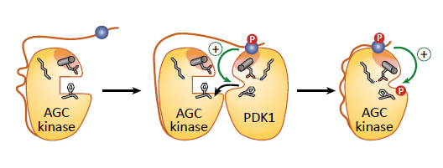
Phosphoinositide-Dependent Protein Kinase 1
AGC Kinases (PKA, PKG, PKC..) are activated by phosphorylation of hydrophobic motif present at C- terminal.
PIF- pocket – PDK1 interacting fragment pocket
How was this mechanism validated?
Hydrogen/deuterium (H/D) exchange studies
Fluorescent ATP analog (TNP-ATP)
Leroux and Biondi, 2020

Slide 10
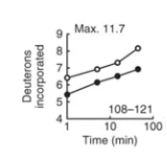

hydrogen/deuterium exchange
The ability to protect or expose regions of the protein to hydrogen/deuterium (¹H/²H) exchange was analyzed.
PDK1 was incubated in the presence or absence of small compounds in buffer containing ²H₂O and the mass of PDK1 was determined by mass spectrometry.
In the absence of compounds, more than nine deuteriums were incorporated in helix αC, indicating a very flexible and dynamic helix αC in solution.
In the presence of low-molecular-weight compounds, a strong protection was observed in helix αB , helix αC, and β-5 strand. Additionally peptides in the ATP- binding sites were also protected.
Hindie et al., 2009

Slide 11
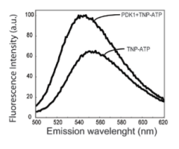
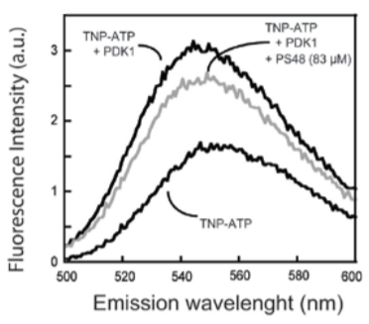
fluorescent TNP-ATP
Probing the ATP binding site conformation in solution with the use of a fluorescent ATP analog, trinitrophenyl-ATP ( TNP-ATP).
TNP-ATP fluorescence intensity increased upon binding to the ATP binding site on PDK1.
The TNP-ATP fluorescence intensity decreased with the subsequent addition of phosphorylated hydrophobic motif polypeptides and with the addition of PS48 or PS08 activating compounds.
Hindie et al., 2009

Slide 12
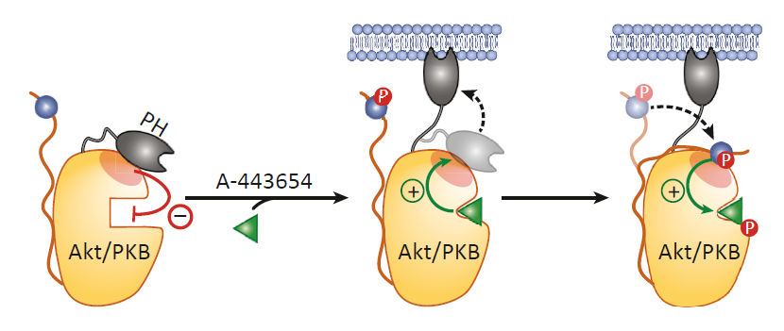
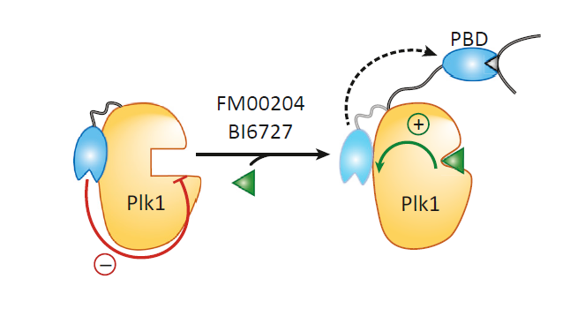
Reverse Allosteric Regulation :
ATP-Binding Site to the Regulatory Hotspot
A-443654 potentiates the binding of the Akt PH domain to PIP₃ and increases the phosphorylation levels of the activation loop and the hydrophobic motif.
Drugs binding to the ATP-binding site of Plk1 release the intramolecular interaction of the polo-box domain (PBD) with Plk1
Leroux and Biondi, 2020

Slide 13
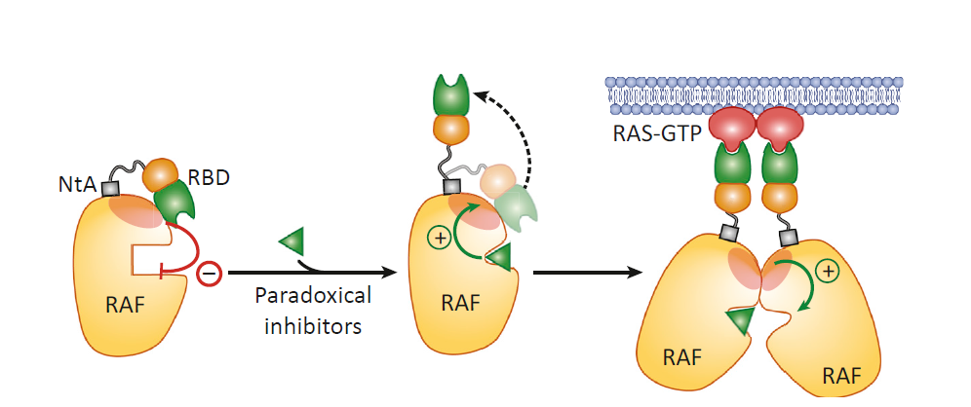
The activation of RAF kinases requires a shift from an autoinhibited monomer to a catalytically active state characterized by adoption of a side to-side dimer.
RAF inhibitors that bind the ATP-binding site, originally designed to inhibit B-RAF and its oncogenic signaling, showed paradoxical enhancement of RAF enzymatic activity, increasing ERK signaling, and as a result increasing cellular proliferation
Leroux and Biondi, 2020

Slide 14
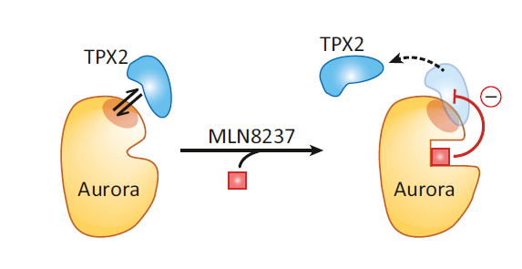
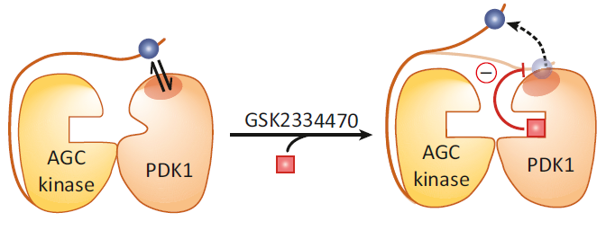
Allosteric Inhibition of Protein Kinase Interactions
ATP-competitive inhibitor of PDK1, GSK2334470 potently disrupted interactions at the PIF-pocket regulatory site.
Aurora A is also activated by the oncogene N-myc and this interaction stabilizes N-myc. ATP-binding site inhibitors disrupts this interaction.
Leroux and Biondi, 2020

Slide 15
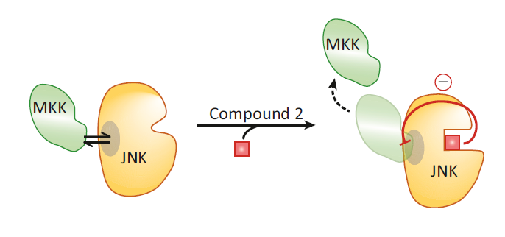
Mitogen-activated protein kinases (JNK, ERK, and p38) possess docking site at the back of the kinase, behind the hinge region. Compounds that target the ATP-binding site stabilize different conformations of the protein, enhancing and disrupting docking interactions.
Leroux and Biondi, 2020

Slide 16
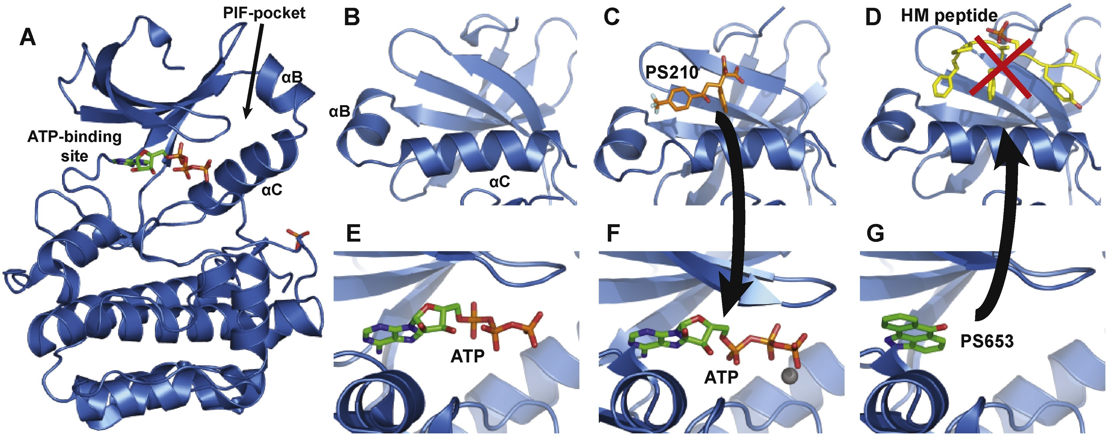
The Mechanism of Bidirectional Allostery
Protein kinases has an equilibrium with an allosteric coupling between the active site and regulatory sites.
At a molecular level, this allosteric transitions rely on dynamic organization–reorganization of key hydrophobic residues.
Leroux et al., 2018

Slide 17
THANK YOU ☺

